Slide 1
BOSH Deep Dive
Pivotal

Slide 2

The Plan
Learn BOSH
Do Lots of Hands On Labs with BOSH
Q+A

Slide 3
What Problem Does BOSH Solve?
BOSH Overview
Notes:
We start with a fast paced nattarive that sets the stage / narrative for the problem that BOSH solves

Slide 4

Imagine you are running a successful SaaS product!

Slide 5

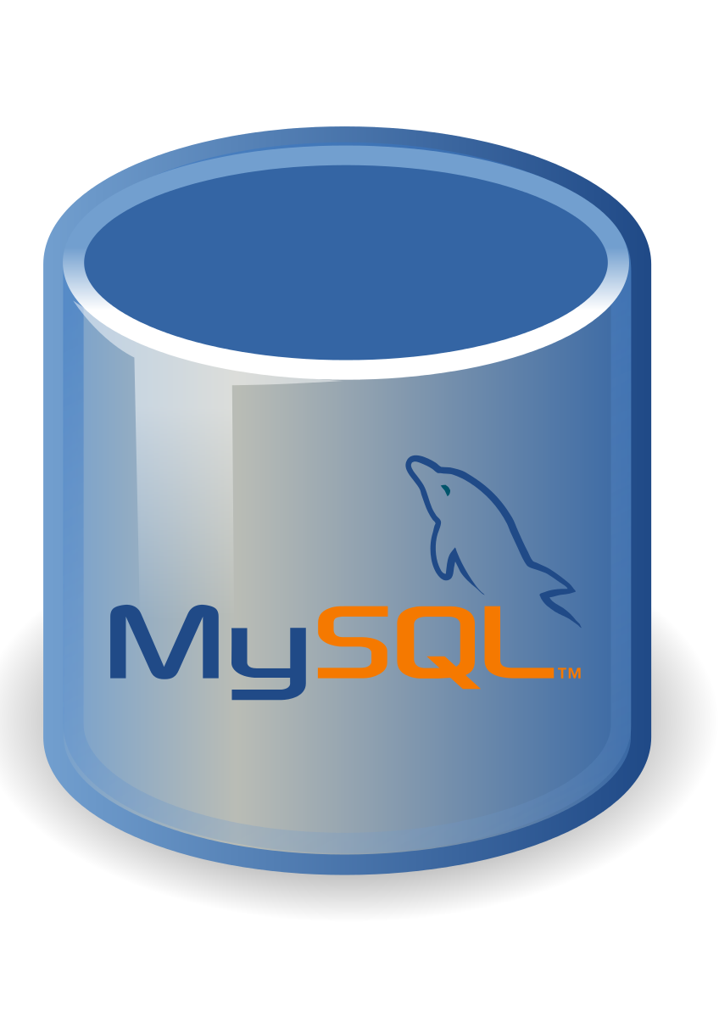







BOSH Deployed & Managed Databases

Slide 6



BOSH Deployed & Managed Messaging Clusters

Slide 7



BOSH Deployed & Managed Data Grids

Slide 8


BOSH Deployed & Managed CI/CD Servers

Slide 9
How do you deploy this SaaS system?
HA Proxy
Tomcat
Rails App
Go App
Tomcat
Rails App
Go App
Java App
Rails App
Go App
Redis
Postgres
RabbitMQ
Redis
Postgres
RabbitMQ
Redis
RabbitMQ
Redis

Slide 10
How do you replicate the environment?
HA Proxy
Tomcat
Rails App
Go App
Staging
Tomcat
Rails App
Go App
Java App
Rails App
Go App
Redis
Postgres
RabbitMQ
Redis
Postgres
RabbitMQ
Redis
RabbitMQ
Redis
HA Proxy
Tomcat
Rails App
Go App
Tomcat
Rails App
Go App
Java App
Rails App
Go App
Production
Redis
Postgres
RabbitMQ
Redis
Postgres
RabbitMQ
Redis
RabbitMQ
Redis

Slide 11

Deployment Manual

Slide 12


A customer offers you lots of money to deploy your solution in their own data center …..

Slide 13


Typical Response
Way Too HARD!

Slide 14


OR
Burn the deployment
Manual
Use BOSH!!!

Slide 15



Cloud Native Container Platform이 필요한 이유
Speed
Stability + Scalability
Security
신속한 앱 배포
애플리케이션 고가용성
무중단 보안 패치
최신 플랫폼 업그레이드
플랫폼 고가용성
네트워크 보안관리
업그레이드 소요시간
클러스터 스케일링
플랫폼 데이터 보안
Notes:
Amazon: 3.75초

Slide 16
What can BOSH Deploy & Manage?
BOSH Overview

Slide 17



BOSH 및 Ansible
VM 상태 점검
Day2
VM 모니터링
VM 업그레이드
Day1
환경 구축

Slide 18







BOSH vs Ansible
Infra Services
운영 및 감시
Other system
Server Configuration
서버 설정
BOSH
Ansible
Infra Orchestration
인프라 구축
Manual
Infrastructure
인프라 제공

Slide 19
Install
IaaS의 설정(Tenant, NW 등)
OpsManager 설치
Elastic Runtime 설정
Elastic Runtime 설치
IaaS의 설정(Tenant, NW 등)
VM 생성
(호스트별) 공개 키의 작성 및 배포
(호스트별) Subscription 활성화
(호스트별) 패키지 설치
OpenShift 설치 설정 파일 생성
OpenShift 설치
Infra Orchestration
PCF는 규모에 관계없이 작업 공수가 일정

Slide 20

PCF의 운영 비용이 낮은 이유
Deployment
OpsManager
(BOSH)
Release 및 Stemcell을 사용하여 특정 구성으로 여러 대의 VM을 만들도록 지시
BOSH가 자동으로 생성
VM 수동 생성 및 VM별 별도 작업 불필요
Release: 1.10.1
Stemcell: 20170501.xxxx
Controller x2
m1.medium
50GB Storage
DB x1
StaticIP: xxx.xxx.xxx.xxx
Diego x3
t2.xlarge
Release
Ｓtemcell
새로운 Stemcell에서 VM을 다시 작성
새로운 Release 설치 및 구성
VM
VM
VM
VM
VM
VM
Infrastructure

Slide 21


Pivotal Cloud Foundry의 운영 면에서의 장점
Before PCF
After PCF
애플리케이션
애플리케이션
애플리케이션
애플리케이션
애플리케이션
애플리케이션
애플리케이션
애플리케이션
VM
VM
VM
VM
VM
VM
구축
애플리케이션이나 VM 확장에 따라 운영 부담이 증가하고. 인원 확장 필요
설정
감시
장애
개별 애플리케이션 컨테이너 관리 PCF에 위임하기 때문에 애플리케이션이 늘어도 운영 부담이 없음
갱신

Slide 22
BOSH can deploy & Manage any distributed system that runs on Virtual Machines!
What can BOSH Deploy & Manage?

Slide 23
Pivotal Cloud Foundry
BOSH Overview

Slide 24
Pivotal Cloud Foundry
Application Code & Frameworks
Buildpacks | Spring Boot | Spring Cloud | Steeltoe
Continuous
delivery
Github
Public Cloud Services
Pivotal Network
Open Service Broker API
Pivotal Application Service (PAS)
Pivotal Container Service (PKS)
Pivotal Services Marketplace
Customer Managed Services
Concourse
>cf push
>kubectl run
Pivotal and
Partner Products
v1
CVEs
Product Updates
Java | .NET | NodeJS
Elastic | Packaged Software | Spark
v2
“3Rs”
v3
PCF Ops Manager/ BOSH
Embedded OS
(Windows & Linux)
NSX-T
Repair
— CVEs
Repave
Rotate
— Credhub
...
Concourse
CPI (15 methods)
vSphere
Openstack
AWS
Google Cloud
Azure & Azure Stack

Slide 25
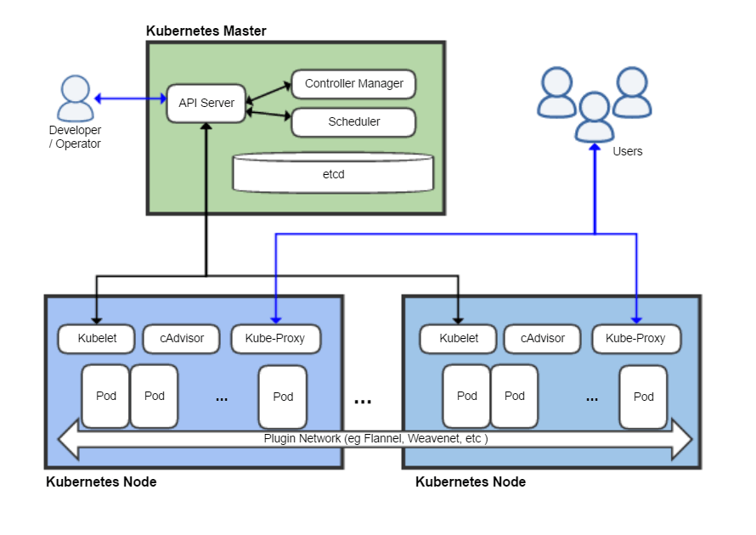

BOSH Deployed & Managed Kubernetes

Slide 26
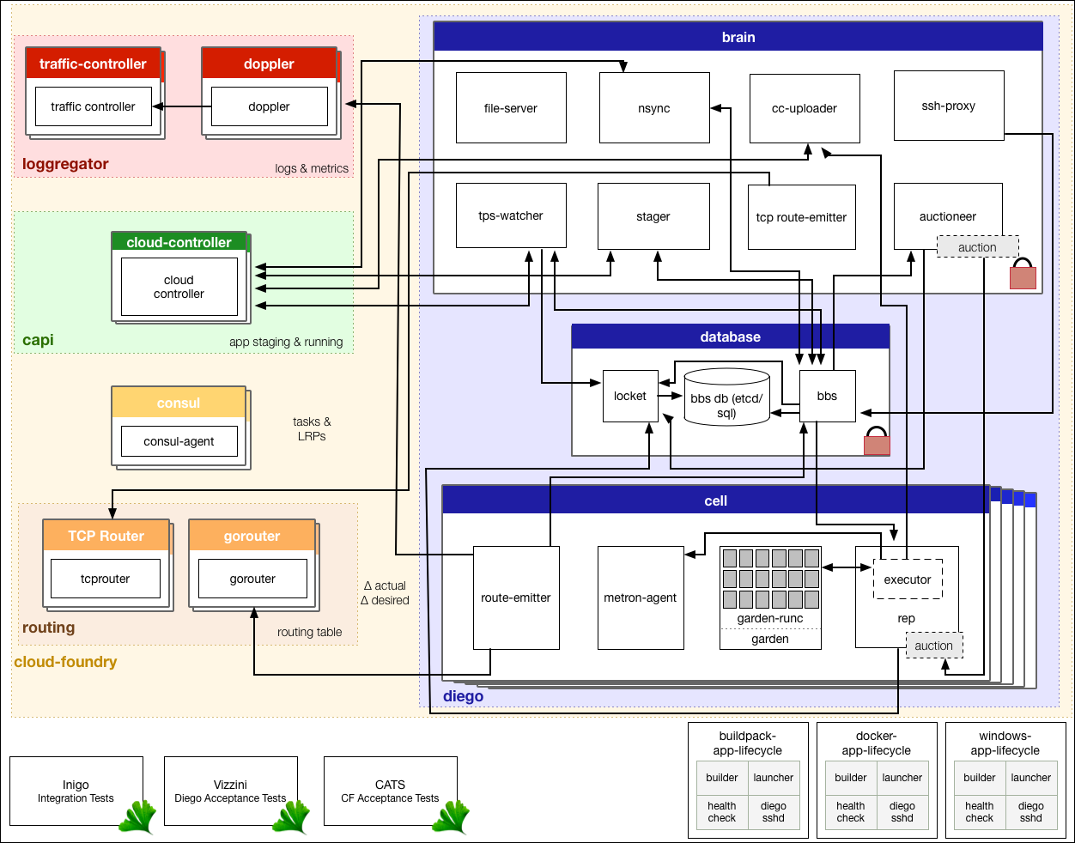

BOSH Deployed & Managed Cloud Foundry

Slide 27
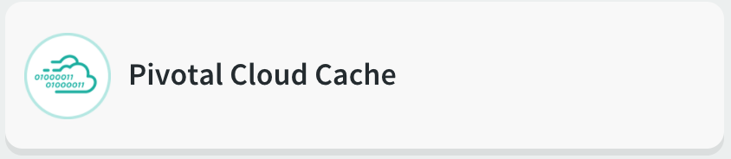
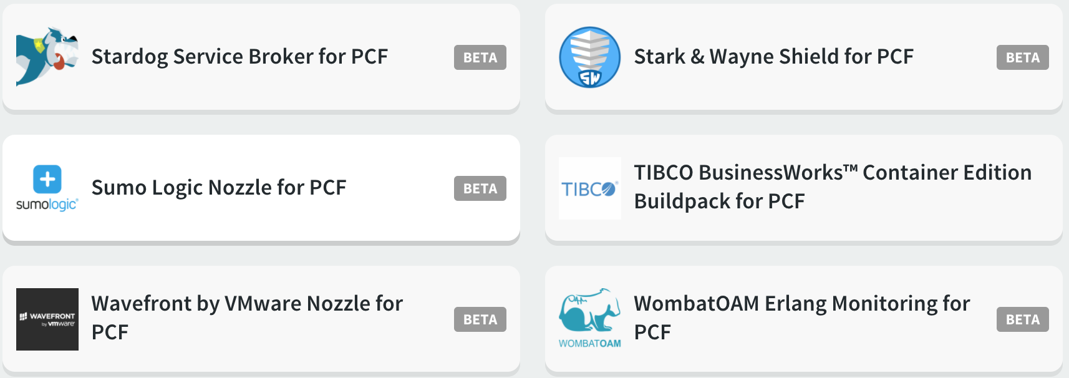
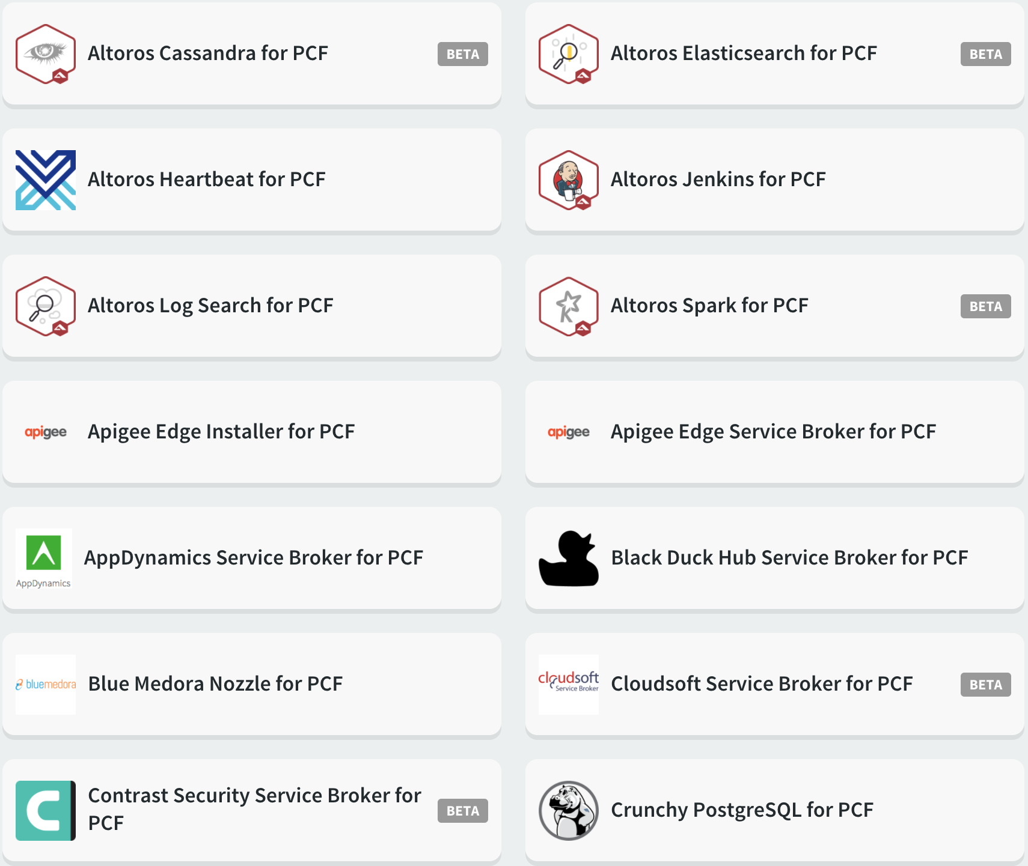
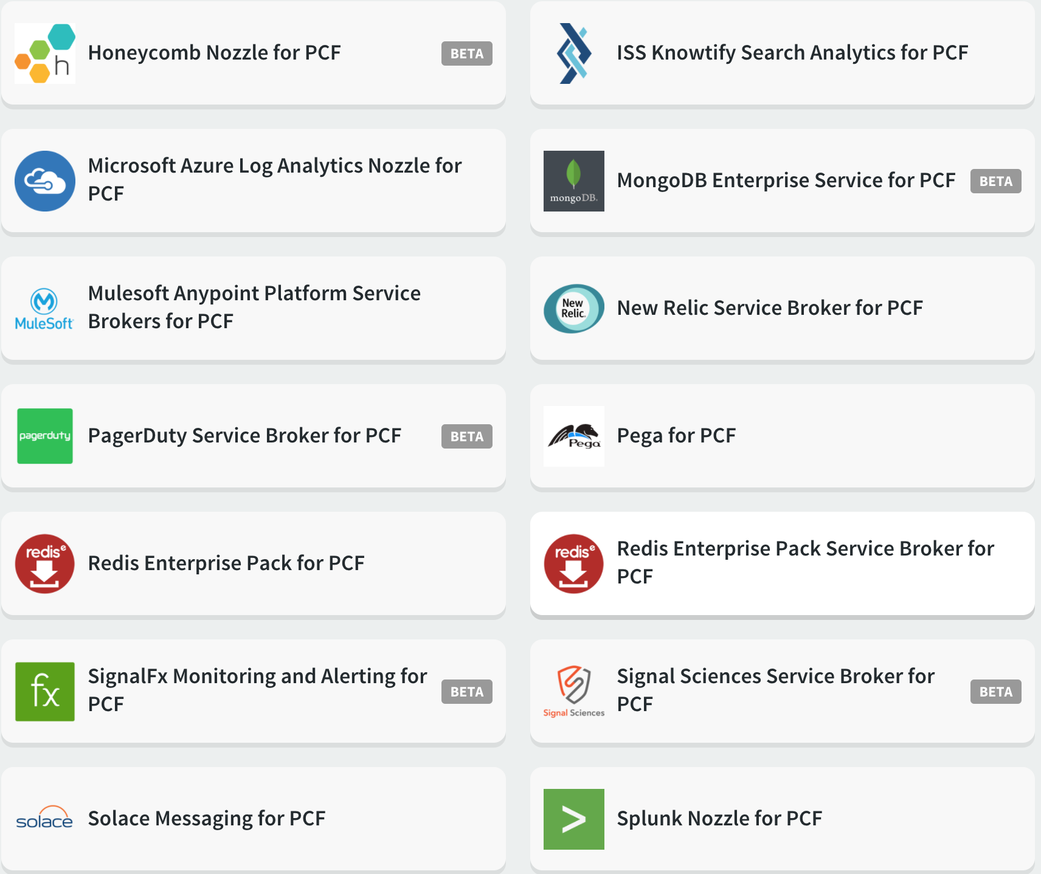
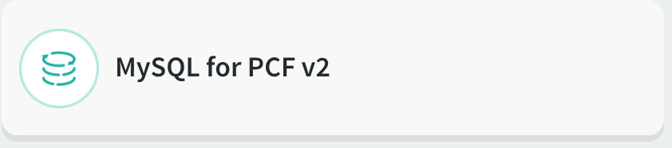

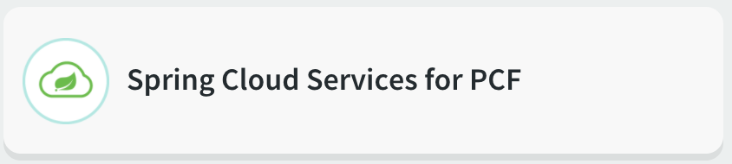
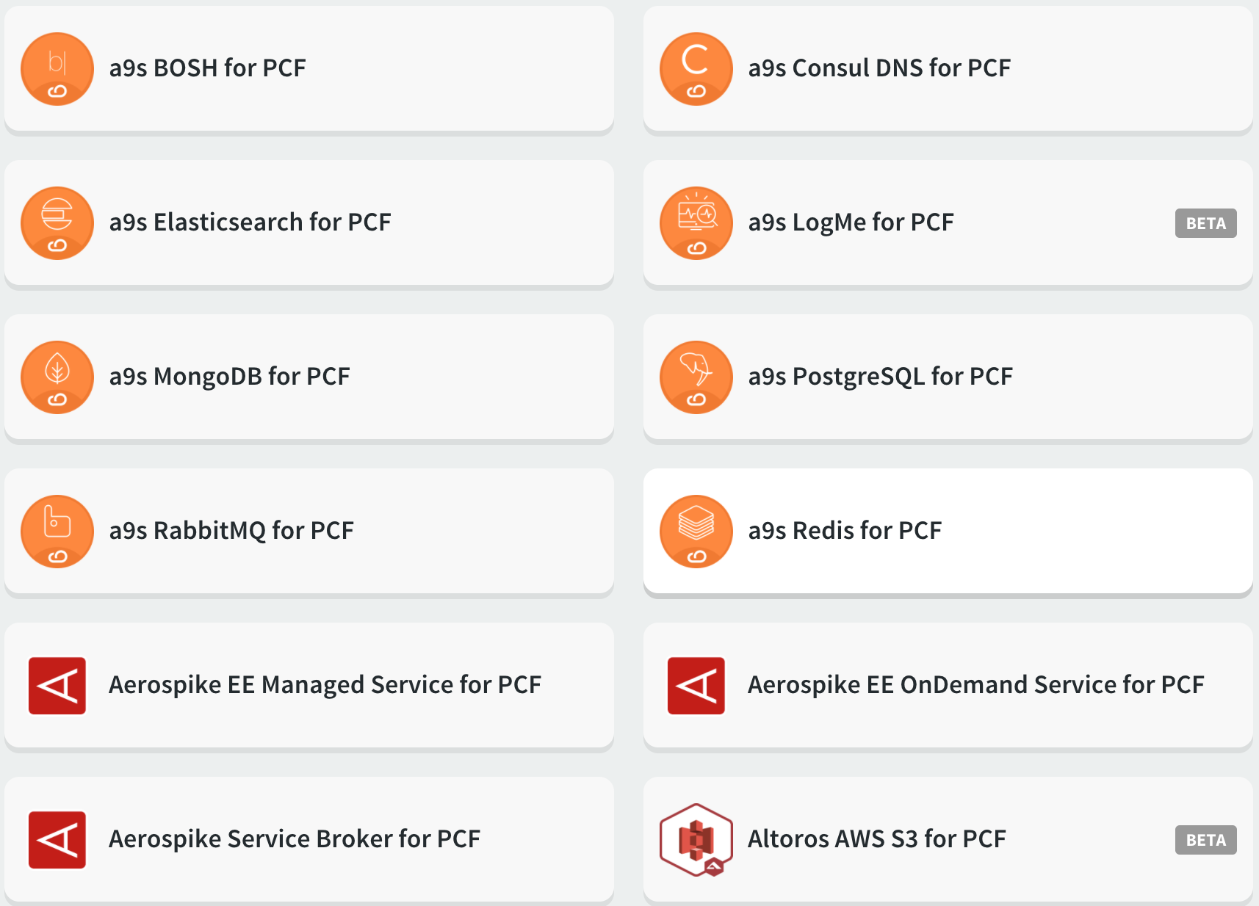




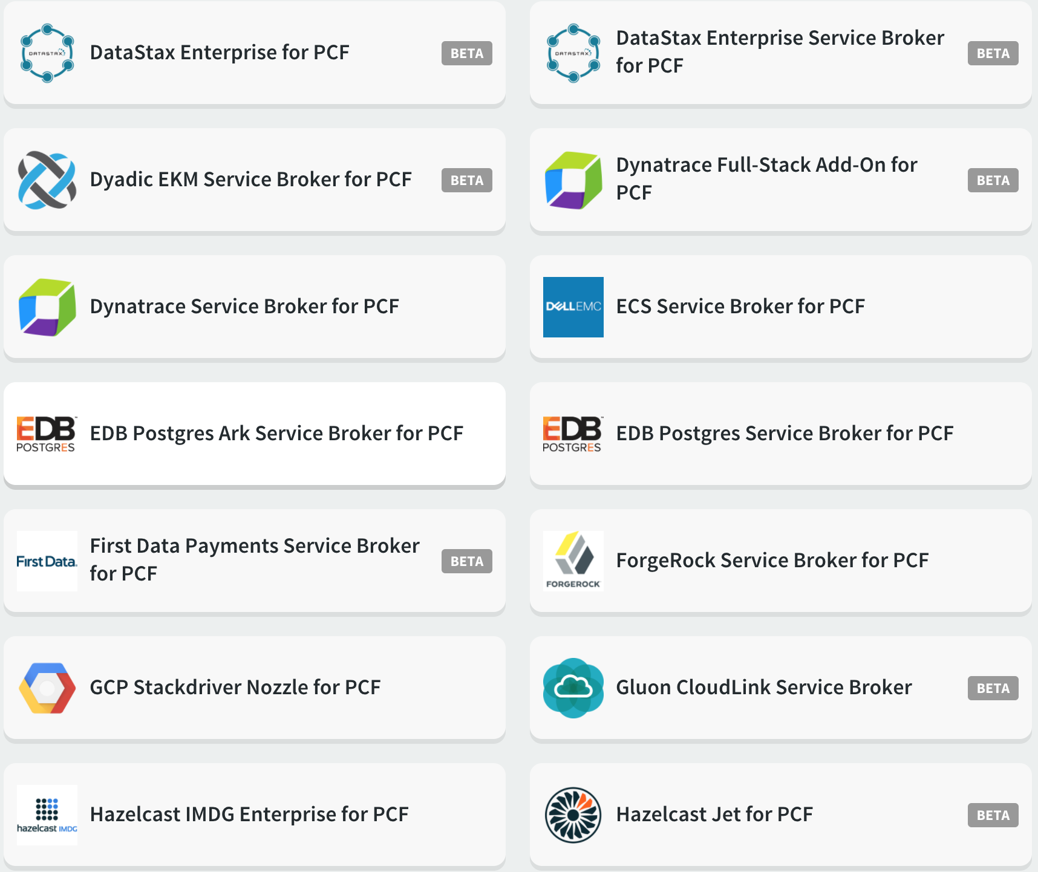
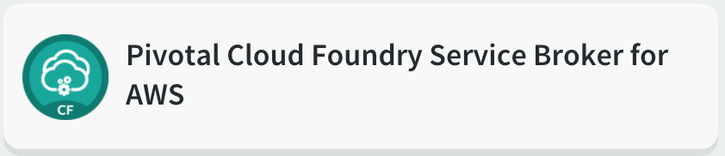
PCF Managed Services
Pivotal
Partners

Slide 28
What is BOSH?
BOSH Overview

Slide 29
What is BOSH?
BOSH is an open source tool for release engineering, deployment, lifecycle management, and monitoring of distributed systems
BOSH installs and updates software packages on large numbers of VMs over many IaaS providers with the absolute minimum of configuration changes
BOSH orchestrates initial deployments and ongoing updates that are:
Predictable, repeatable, and reliable
Self-healing
Infrastructure-agnostic

Slide 30







What IaaS providers does BOSH support?

Slide 31


What Operating Systems Does BOSH Support?
Linux

Slide 32

The BOSH Project
BOSH was created in 2010 by VMWare
2013 Pivotal was spun out of VMWare taking BOSH with it
Pivotal donated the BOSH project the the Cloud Foundry Foundation
BOSH is a project of the Cloud Foundry Foundation
BOSH uses the Apache 2.0 License
Actively developed since 2010
244 Contributors
Major contributions from CF Foundation members Pivotal, IBM, SAP, VMware, Microsoft, Google and others
Resources
http://bosh.io
http://ultimateguidetobosh.com/ (Free Book)
http://mariash.github.io/learn-bosh/ (Quick Tutorial)
https://cloudfoundry.org/bosh/
https://github.com/cloudfoundry/bosh

Slide 33
BOSH User Interaction
The BOSH director is a collection of components that orchestrates the initial deployments and ongoing updates of bosh managed services
BOSH is a distributed system that can be deployed on multiple VM’s. However it is commonly deployed on a single VM.
A single BOSH director VM can manage thousands of other VMs
The BOSH CLI is a single go binary that can be installed on a Mac, Windows, or Linux to drive the BOSH director
BOSH Director
VM
BOSH CLI
Director
Notes:
Bosh v1 cli was written in ruby and is not covered in this workshop

Slide 34
Configure the BOSH cli
ssh into the jumbox
Use the BOSH cli to log into the BOSH director
Follow Along Demo

Slide 35
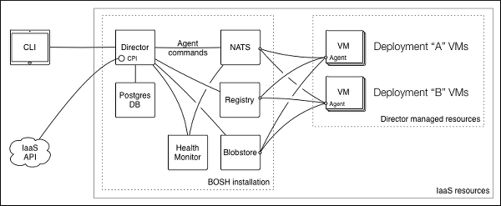
BOSH Architecture

Slide 36
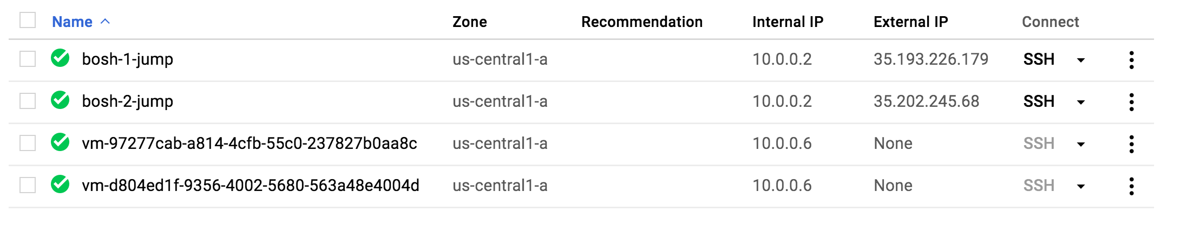
Example Jump BOX & Director
BOSH director is typically deployed on a network with no external access
A jumbox / bastion host is deployed alongside the bosh director to interact with the direct via the cli
Below is a screenshot of a gcp project showing two directors and a two jump boxes notice that the directors have no external ip addresses

Slide 37
Alias the BOSH director
$ bosh alias-env my-bosh -e 10.0.0.6 --ca-cert <(bosh int ./creds.yml --path /director_ssl/ca) Using environment '10.0.0.6' as anonymous user Name bosh-1 UUID 377b7bf5-4e1f-4103-880f-ee7e12a8373e Version 264.1.0 (00000000) CPI google_cpi Features compiled_package_cache: disabled config_server: enabled dns: disabled snapshots: disabled User (not logged in) Succeeded

Slide 38
Find the BOSH director admin password
$ bosh-1@bosh-1-jump:~$ bosh int ./creds.yml --path /admin_password
9ql9hrdxo7gq5hyyjnup
Succeeded
$ cat creds.yml
admin_password: 9ql9hrdxo7gq5hyyjnup
blobstore_agent_password: po2ljw087dzy2o4k97qs
blobstore_director_password: n3tenfvllwipirvsxsyw
credhub_ca:
ca: |
-----BEGIN CERTIFICATE-----
MIIEIzCCAougAwIBAgIQEohzHW3Fhaz0m/D4ns3PsjANBgkqhkiG9w0BAQsFADA7
MQwwCgYDVQQGEwNVU0ExFjAUBgNVBAoTDUNsb3VkIEZvdW5kcnkxEzARBgNVBAMT
CkNyZWRIdWIgQ0EwHhcNMTcxMTIxMDUxMDQwWhcNMTgxMTIxMDUxMDQwWjA7MQww
CgYDVQQGEwNVU0ExFjAUBgNVBAoTDUNsb3VkIEZvdW5kcnkxEzARBgNVBAMTCkNy
ZWRIdWIgQ0EwggGiMA0GCSqGSIb3DQEBAQUAA4IBjwAwggGKAoIBgQDQRmjMHCEd
W1HhD/IDkAemiInuVySYDLkpQXs7xfsjgjsnnDTXcZ4Lt1Ao+W85H9etYdOiBZTp
cu/sSfdVCI/suDzQTzxqCET441lDkYPEWCDWbQo4eMRnK4PyIWffUnV3HXtyS/4D
HkCkXVPX6UVF7OBd+C7S0R2vKbgxsFQsRBWKlFuhA7+3ndEs9odVi9YKQcJnk2tF
kPsoiPRGgQuCwLf44RiPpPgDJbB3fNL3VAIjmt6h1z472f3IkZqsKdpnimIWty9w
KDUEiTYwwIIien7F7odi3AyiYUXTzTuE2EVs/otWdKY6lV3ARcjwCACh/mCO5St2
5jKfJ/f3MyXL2dAZ55RvDH3k7Bq9iCHIgBw/46IQAqk0Z4c6wdokZpIY6KZHiGcY
… many more creds & certificates

Slide 39
Log into the director
$ bosh -e my-bosh login Email (): admin Password (): Successfully authenticated with UAA Succeeded
$ bosh -e my-bosh environment Using environment '10.0.0.6' as user 'admin' (openid, bosh.admin) Name bosh-1 UUID 377b7bf5-4e1f-4103-880f-ee7e12a8373e Version 264.1.0 (00000000) CPI google_cpi Features compiled_package_cache: disabled config_server: enabled dns: disabled snapshots: disabled User admin

Slide 40
Demo
Connecting to a bosh director
Deploying a Kubernetes cluster with BOSH
Overall BOSH
Notes:
Instructor Only -- Shows how awesome BOSH is. Get people interested!

Slide 41
Stemcell
BOSH Concepts

Slide 42
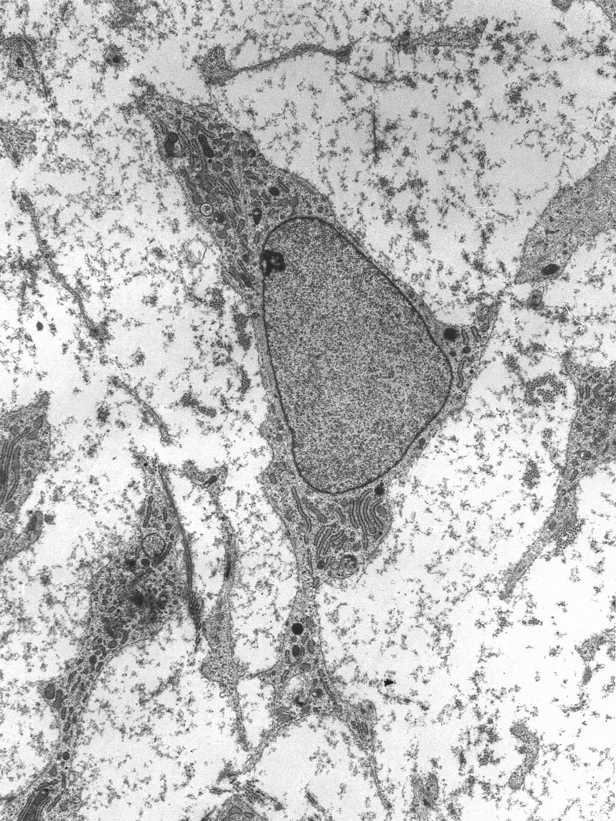
What is a stemcell?
In biology a stemcell is a cell that can morph into a specialized cell
stemcell → bone cell
stemcell → liver cell
stemcell → skin cell
In BOSH a stemcell is a bare minimum OS image that can be morphed into a VM running specific software
stemcell → VM running Redis
stemcell → VM running HAProxy
stemcell → VM running all the components of a Kubernetes worker node

Slide 43
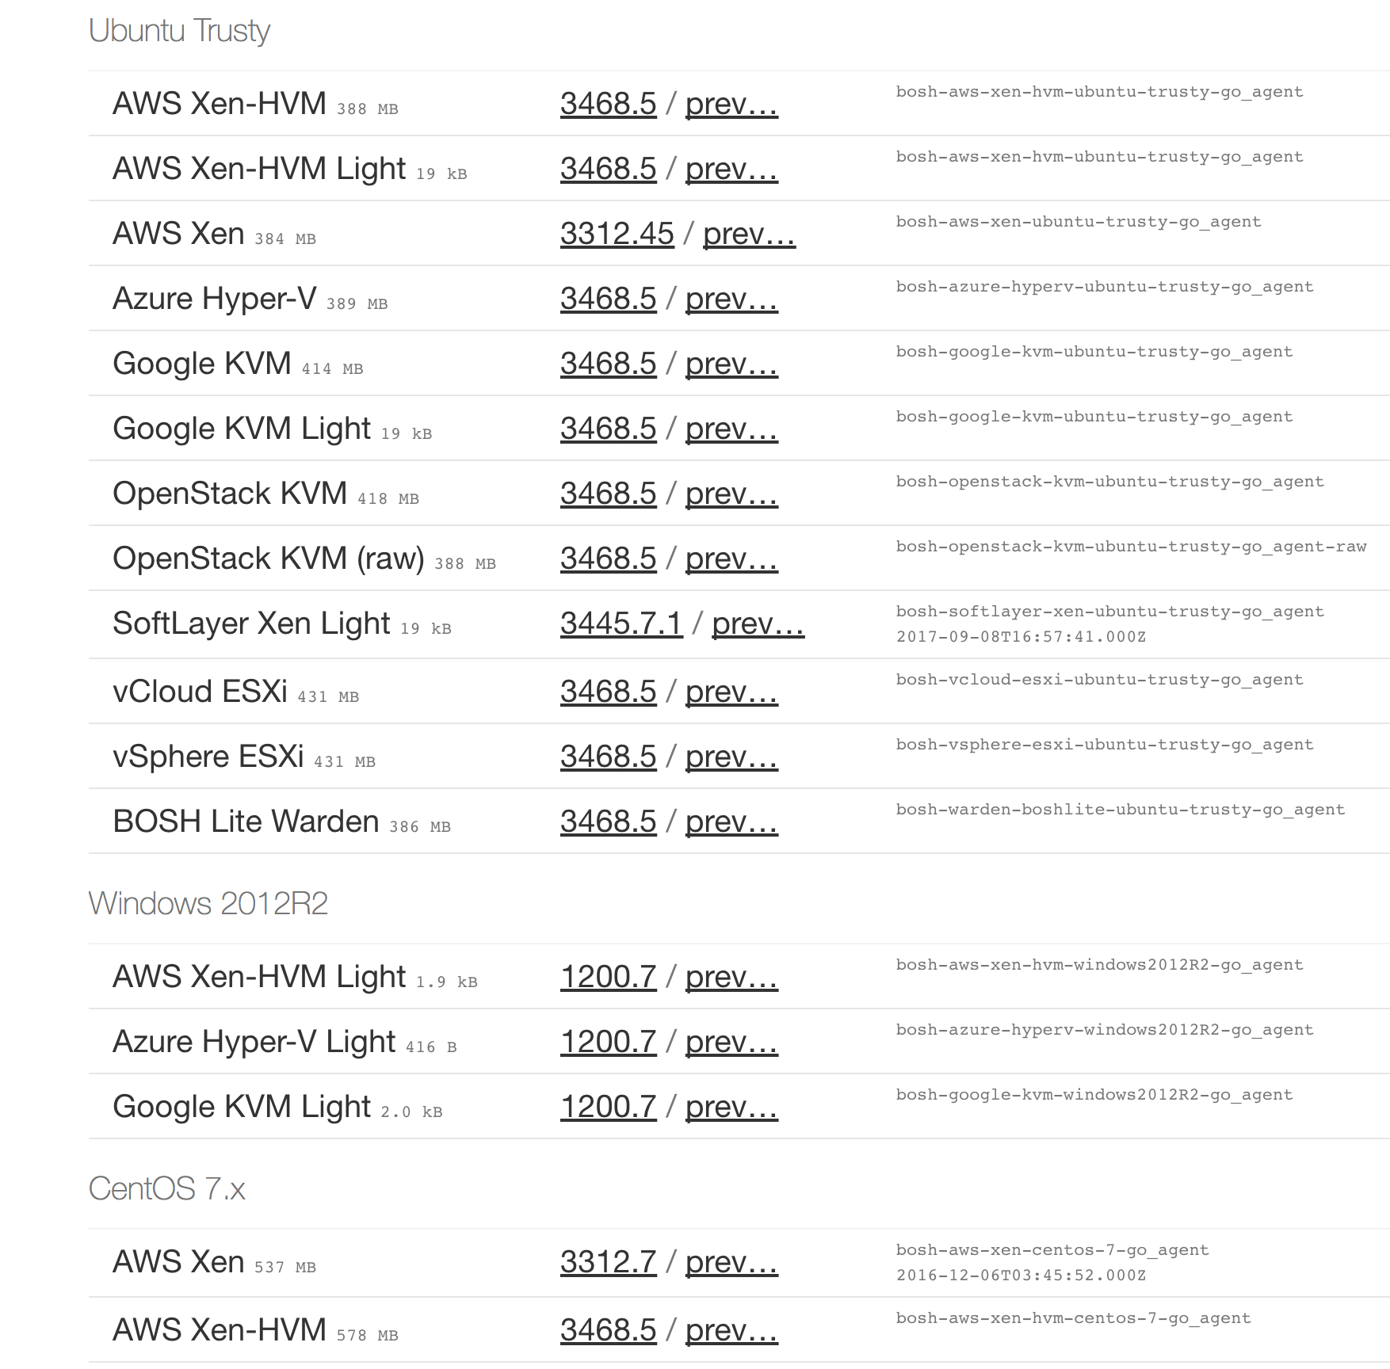
BOSH Stemcell
Secured, hardened, and versioned operating system image wrapped with IaaS specific packaging
Contains a bare minimum OS skeleton with a few common utilities pre-installed, a BOSH Agent, and a few configuration files to securely configure the OS by default
Stemcells are Windows or Linux based
Maintained by BOSH team and available at http://bosh.io/stemcells

Slide 44
Examining a BOSH Stemcell
Download a stemcell from bosh.io
Extract the downloaded stemcell
Examine the contents of a stemcell
Follow Along Demo

Slide 45
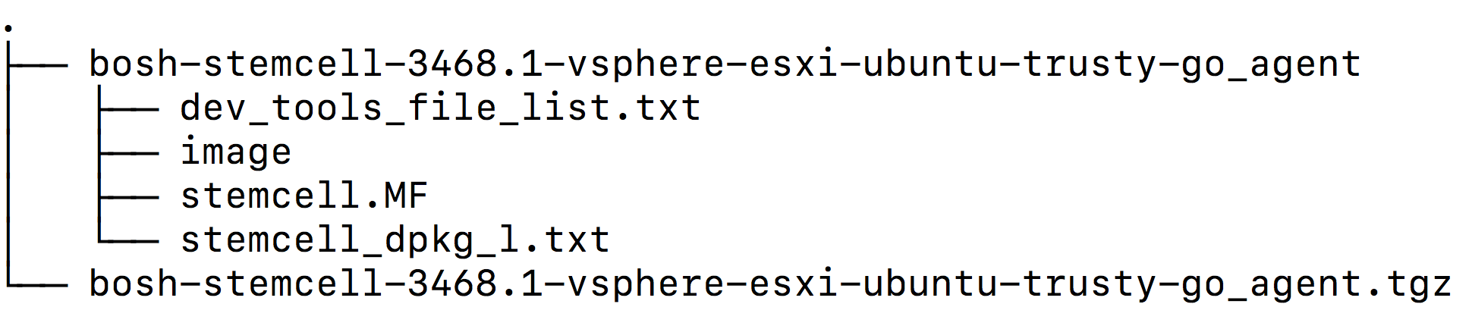
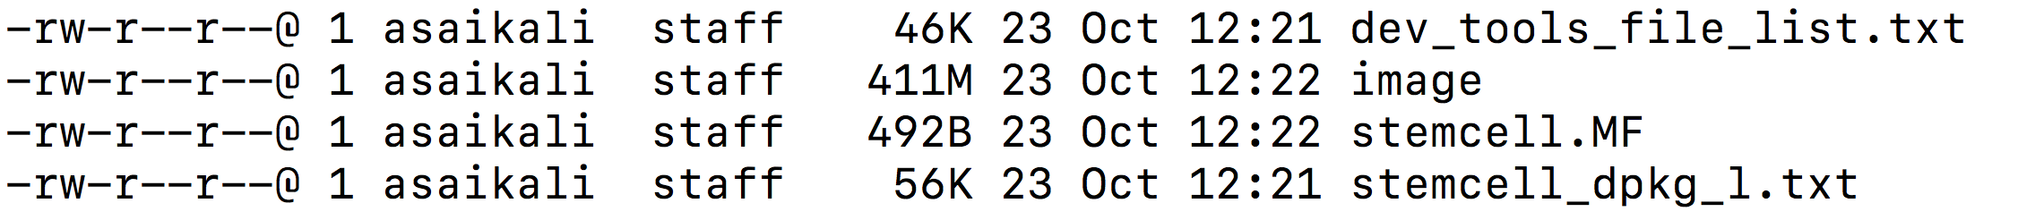
Contents of vSphere Stemcell downloaded from bosh.io

Slide 46
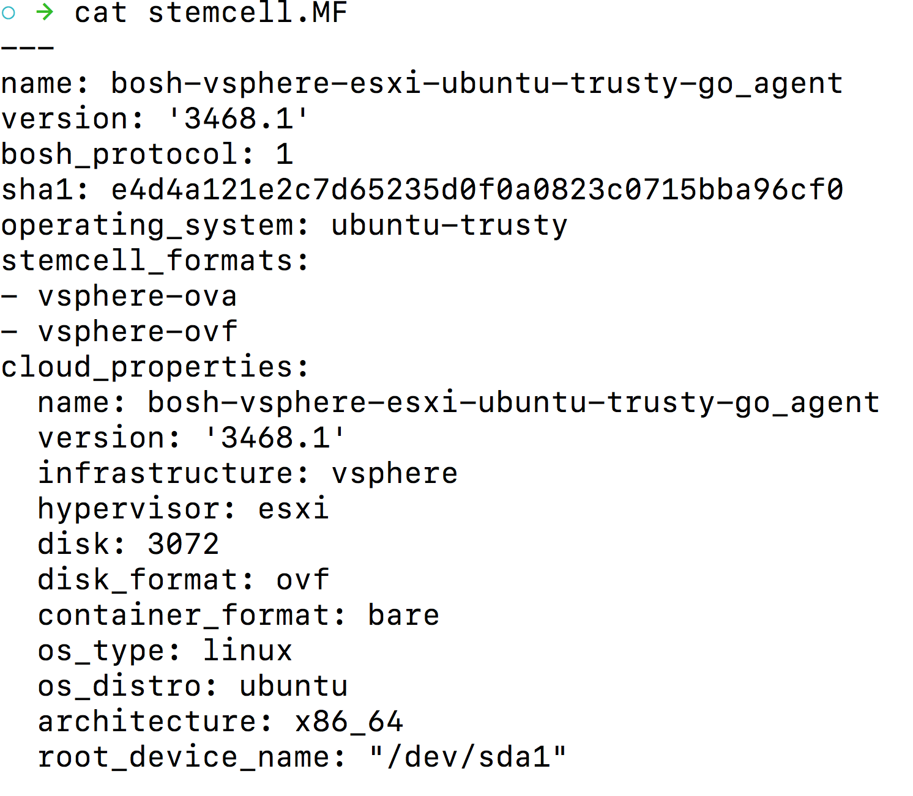
Stemcell - stemcell.MF
Stemcell Metadata -
MAJOR.MINOR format
Major version is incremented when new features are added to stemcells
Minor versions are incremented if certain security fixes backported on top of existing stemcell line.
We recommend to continuously bump to the latest major stemcell version to receive latest updates.

Slide 47
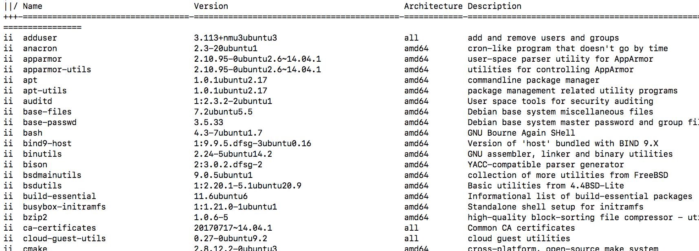
Stemcell - stemcell_dpkg_l.txt

Slide 48
Demo
Bootup a stemcell
Log into the stemcell
Tour what’s on the stemcell
Boot the stemcell image
Notes:
Optional for workshop attendees to follow along or do it themselves

Slide 49
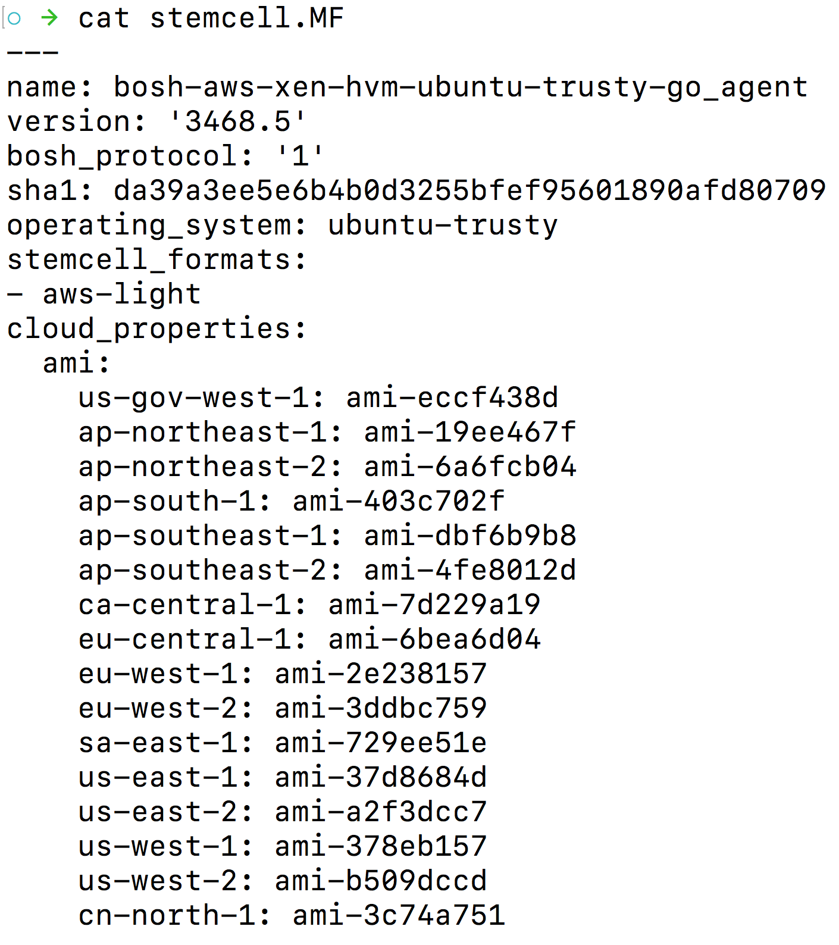
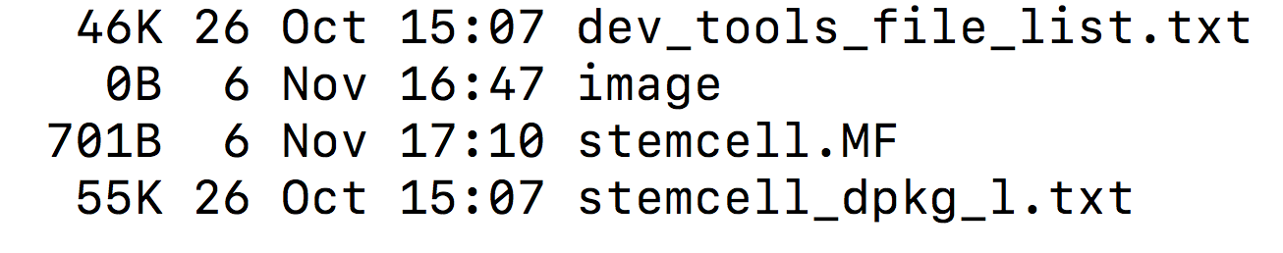
Light Stemcells
Available for public IaaS providers only
AWS
GCP
Azure
SoftLayer
Small size file only about 20KB thus the name light stemcell
Does not contain the OS image rather references the OS image hosted by the IaaS provider

Slide 50
Why Stemcells?
BOSH Concepts

Slide 51
The concept of stemcell solves the following problems
Provides a base operating system image for installing software packages on
Versions changes to the OS image.
If a library is changed for example openssl a new stemcell version is released
Provides traceability of what is running on a VM
Guarantees reproducibility
Reusing base Operating System images across VMs of different types
Eliminates snowflakes in your systems
Simplifies patching / upgrades / maintenance
Simplifies troubleshooting
Reusing base Operating System images across different IaaS providers
BOSH software release only need to be built once and they will work the same on all IaaS providers
Stemcells are pre-hardened according to security best practices
Building on top of a stemcells means more secure software
https://docs.pivotal.io/pivotalcf/1-12/security/pcf-infrastructure/stemcell-hardening.html

Slide 52
Uploading a Stemcell
Download a stemcell from bosh.io
Upload the stemcell to the bosh director
Query the bosh director to list all the stemcells it is storing
Follow Along Demo

Slide 53
Downloading stemcell from bosh.io
$ wget --content-disposition https://s3.amazonaws.com/bosh-core-stemcells/google/bosh-stemcell-3468.5-google-kvm-ubuntu-trusty-go_agent.tgz --2017-11-21 17:02:48-- https://s3.amazonaws.com/bosh-core-stemcells/google/bosh-stemcell-3468.5-google-kvm-ubuntu-trusty-go_agent.tgz Resolving s3.amazonaws.com (s3.amazonaws.com)... 54.231.81.35 Connecting to s3.amazonaws.com (s3.amazonaws.com)|54.231.81.35|:443... connected. HTTP request sent, awaiting response... 200 OK Length: 413686445 (395M) [application/x-tar] Saving to: ‘bosh-stemcell-3468.5-google-kvm-ubuntu-trusty-go_agent.tgz’ 100%[==============================================================================================>] 413,686,445 44.4MB/s in 1m 50s 2017-11-21 17:04:39 (3.59 MB/s) - ‘bosh-stemcell-3468.5-google-kvm-ubuntu-trusty-go_agent.tgz’ saved [413686445/413686445]

Slide 54
Uploading stemcell to the BOSH Director
$ bosh -e my-bosh upload-stemcell bosh-stemcell-3468.5-google-kvm-ubuntu-trusty-go_agent.tgz Using environment '10.0.0.6' as user 'admin' (openid, bosh.admin) ########################################################## 100.00% 99.88 MB/s 3s Task 3 Task 3 | 17:05:12 | Update stemcell: Extracting stemcell archive (00:00:05) Task 3 | 17:05:18 | Update stemcell: Verifying stemcell manifest (00:00:00) Task 3 | 17:05:20 | Update stemcell: Checking if this stemcell already exists (00:00:00) Task 3 | 17:05:20 | Update stemcell: Uploading stemcell bosh-google-kvm-ubuntu-trusty-go_agent/3468.5 to the cloud (00:01:20) Task 3 | 17:06:40 | Update stemcell: Save stemcell bosh-google-kvm-ubuntu-trusty-go_agent/3468.5 (stemcell-c141368a-d75d-4bd5-487b-9cffe0d46585) (00:00:00) Task 3 Started Tue Nov 21 17:05:12 UTC 2017 Task 3 Finished Tue Nov 21 17:06:40 UTC 2017 Task 3 Duration 00:01:28 Task 3 done Succeeded

Slide 55
Determining what stemcells exist in the director
$ bosh -e my-bosh stemcells Using environment '10.0.0.6' as user 'admin' (openid, bosh.admin) Name Version OS CPI CID bosh-google-kvm-ubuntu-trusty-go_agent 3468.5 ubuntu-trusty - stemcell-c141368a-d75d-4bd5-487b-9cffe0d46585 (*) Currently deployed 1 stemcells Succeeded

Slide 56
CPI: Cloud Provider Interface
BOSH Concepts

Slide 57





Cloud Provider Interface (CPI)
The bosh director uses the CPI to interact with an IaaS to create and manage stemcells, VMs, and disks.
The CPI abstracts infrastructure differences from the rest of BOSH.
The CPI is a command line executable that can be called to perform any of the actions below
CPIs are typically maintained by the IaaS provider
Disk
`create_disk`
`delete_disk`
`attach_disk`
`detach_disk`
`has_disk`
`get_disk`
Snapshots
`snapshot_disk`
`delete_snapshot`
`current_vm_id`
Stemcell
`create_stemcell`
`delete_stemcell`
VM
`create_vm`
`delete_vm`
`reboot_vm`
`set_vm_metadata`
`configure_networks`

Slide 58


BOSH Component Architecture (Simplified)
IaaS API
BOSH Director
VM
bosh managed vm
Cloud Provider Interface
Redis
BOSH CLI
Director
BOSH Agent
IaaS
NATS
bosh managed vm
Postgres
DB
HAProxy
BOSH Agent

Slide 59
Demo
Show where BOSH interacts with the infrastructure by examining the logs from the previous demo
CPI

Slide 60
How do I abstract the cloud away?
BOSH Concepts

Slide 61
Cloud-Config
The specific details about the size of the servers is specific to each cloud infrastructure.
Take the makeup of a VM as an example:
On vSphere, you will want to specify the explicit allocation of CPUs, RAM, and ephemeral disk.
On Amazon Web Services you might choose between a list of Instance Types such as m4.large or t2.medium.
On GCP you choose a Machine Type from a list of predefined sizes which are slightly different than Amazon such as n1-standard-1.
The Cloud Config is where BOSH takes specific infrastructure details to configure the CPI being used while abstracting the complexities away from the software you are deploying.

Slide 62
Example GCP cloud-config.yml
azs:
- name: z1
cloud_properties: {zone: us-central1-a}
- name: z2
cloud_properties: {zone: us-central1-f}
vm_types:
- name: default
cloud_properties:
machine_type: n1-standard-4
root_disk_size_gb: 20
root_disk_type: pd-ssd
disk_types:
- name: default
disk_size: 3000
networks:
- name: default
type: manual
subnets:
- range: 10.0.0.0/16
gateway: 10.0.0.1
dns: [8.8.8.8, 8.8.4.4]
reserved: [10.0.0.0-10.0.0.10]
azs: [z1, z2]
cloud_properties:
ephemeral_external_ip: true
subnetwork_name: bosh-1-sub
network_name: bosh-1-net
ephemeral_external_ip: true
tags: [bosh]
- name: vip
type: vip
compilation:
workers: 3
reuse_compilation_vms: true
az: z1
vm_type: default
network: default

Slide 63
Create and Upload the Cloud-Config
Follow Along Demo

Slide 64
Create and Upload the cloud-config
Create a basic cloud-config
Use the BOSH cli to upload cloud-config to the director
Follow Along Demo

Slide 65
Set the BOSH director cloud configuration
$bosh -e my-bosh update-cloud-config cloud-config.yml Using environment '10.0.0.6' as user 'admin' (openid, bosh.admin) + azs: + - cloud_properties: + zone: us-central1-a + name: z1 + - cloud_properties: + zone: us-central1-f + name: z2 Command prints out the whole cloud-config.yml, lines have been removed to make it fit on the slide + disk_types: + - disk_size: 3000 + name: default Continue? [yN]: y Succeeded

Slide 66
What is a BOSH release?
BOSH Concepts

Slide 67
Suppose you are deploying a very simple 2 VM service
Tomcat
on
Ubuntu
PostgreSQL
on
CentOS

Slide 68
Typical Deployment Steps
Setup Postgres
We need CentOS 7 machine
With 8 GB RAM, 10GB Disk, and one IP Address
Provision the required VM on IaaS (vSphere, AWS, etc)
Get the source for postgres
Compile postgres and install it
Configure postgres as a monitored service
Start postgres and note it’s ip address / port
Setup Tomcat
We need an Ubuntu 16.04 LTS machine
With 4 GB RAM, 10GB Disk, and one IP Address
Provision the required VM on IaaS (vSphere, AWS, etc)
Install the Java Runtime Environment on the VM
Install the Tomcat on the OS
Configure Tomcat as a monitored service
Configure Tomcat data source pointing to postgres
Deploy app into Tomcat
Start tomcat

Slide 69
Deployment Steps Mapped to BOSH Concepts
Setup Postgres
We need CentOS 7 machine
BOSH stemcell
With 8 GB RAM, 10GB Disk, and one IP Address
Provision the required VM on IaaS (vSphere, AWS, etc)
BOSH deployment manifest
Get the source for postgres
Compile postgres and install it
Configure postgres as a monitored service
Start postgres and note it’s ip address / port
BOSH release
Setup Tomcat
Install the Java Runtime Environment on the VM
Install the Tomcat on the OS
Configure Tomcat as a monitored service
Configure Tomcat data source pointing to postgres
Deploy app into Tomcat
Start tomcat
With 4 GB RAM, 10GB Disk, and one IP Address
Provision the required VM on IaaS (vSphere, AWS, etc)
BOSH stemcell
We need an Ubuntu 16.04 LTS machine
BOSH deployment manifest
BOSH release

Slide 70
BOSH Release
A BOSH release is similar to a collection of traditional software packages, such as Debian APT or MacOS Homebrew packages.
A traditional software package focused on installing a single piece of software.
Executable (The software)
Library (Dependencies)
A traditional software package might also configure and run a service.
Default Config Files
Startup Script
Monitoring
A BOSH release combines all these functions
Compile all packages for the target operating system and architecture
Install runtime dependencies via BOSH packages
Configuring the software (clustering)
Initialize, and run processes using Monit (monitoring system)

Slide 71
Trivial Sample App that we want to run on a VM
#!/bin/bash
while true
do
echo "Sample APP STDOUT!!!"
sleep 1
done

Slide 72
Upload a BOSH release
Download a bosh release
Upload the release to bosh director
Follow Along Demo

Slide 73
Download the BOSH release
$ wget https://github.com/Oskoss/bosh-release/releases/download/v1.1/sample_release.tgz --2017-11-28 04:47:56-- https://github.com/Oskoss/bosh-release/releases/download/v1.1/sample_release.tgz Resolving github.com (github.com)... 192.30.253.113, 192.30.253.112 Connecting to github.com (github.com)|192.30.253.113|:443... connected.
...
Connecting to github-production-release-asset-2e65be.s3.amazonaws.com (github-production-release-asset-2e65be.s3.amazonaws.com)|52.216.82.184|:443... connected. HTTP request sent, awaiting response... 200 OK Length: 1501 (1.5K) [application/octet-stream] Saving to: ‘sample_release.tgz’ 100%[==============================================================>] 1,501 --.-K/s in 0s 2017-11-28 04:47:56 (64.4 MB/s) - ‘sample_release.tgz’ saved [1501/1501]
$ ls -lah sample_release.tgz -rw-r--r-- 1 bosh-1 root 1.5K Nov 28 04:12 sample_release.tgz

Slide 74
Uploading a BOSH release to the BOSH director
$ bosh -e my-bosh upload-release ~/sample_release.tgz Using environment '10.0.0.6' as user 'admin' (openid, bosh.admin) ########################################################## 100.00% 13.75 KB/s 0s Task 84 Task 84 | 04:54:10 | Extracting release: Extracting release (00:00:00) Task 84 | 04:54:10 | Verifying manifest: Verifying manifest (00:00:00) Task 84 | 04:54:10 | Resolving package dependencies: Resolving package dependencies (00:00:00) Task 84 | 04:54:10 | Creating new packages: sample_app/3698d0cc632d3162a6a2fedcd36ac00364a7cd64 (00:00:00) Task 84 | 04:54:10 | Creating new jobs: sample_job/3772798c13278206d9bdf5d58872f7bc8fa77521 (00:00:00) Task 84 | 04:54:10 | Release has been created: sample-bosh-release/0+dev.1 (00:00:00) Task 84 Started Tue Nov 28 04:54:10 UTC 2017 Task 84 Finished Tue Nov 28 04:54:10 UTC 2017 Task 84 Duration 00:00:00 Task 84 done Succeeded

Slide 75
Determining the release a BOSH director knows about
$ bosh releases
Using environment '10.0.0.6' as user 'admin' (openid, bosh.admin)
Name Version Commit Hash
sample-bosh-release 0+dev.1 a2b19b8
zookeeper 0.0.7* e7ead22
(*) Currently deployed
(+) Uncommitted changes
2 releases
Succeeded

Slide 76
Examining the BOSH release
Examine the contents of a BOSH release and understand what JOBS and packages are
Follow Along Demo

Slide 77
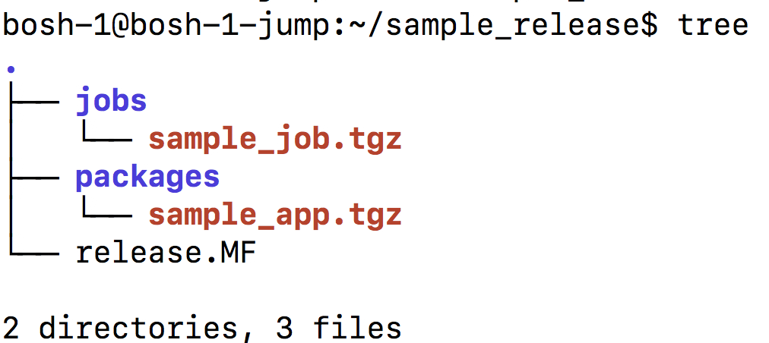
Untar a BOSH Release
$ tar xvf sample_release.tgz -C sample_release release.MF jobs/ jobs/sample_job.tgz packages/ packages/sample_app.tgz

Slide 78
release.MF - A YAML metadata file describing the release
name: sample-bosh-release
version: 0+dev.1
commit_hash: a2b19b8
uncommitted_changes: false
jobs:
- name: sample_job
version: 3772798c13278206d9bdf5d58872f7bc8fa77521
fingerprint: 3772798c13278206d9bdf5d58872f7bc8fa77521
sha1: f9888b65ad57263475369004a73d28c1ac6c6328
packages:
- name: sample_app
version: 3698d0cc632d3162a6a2fedcd36ac00364a7cd64
fingerprint: 3698d0cc632d3162a6a2fedcd36ac00364a7cd64
sha1: d224739b881e9dd957988bcd7513a37edff69205
dependencies: []

Slide 79
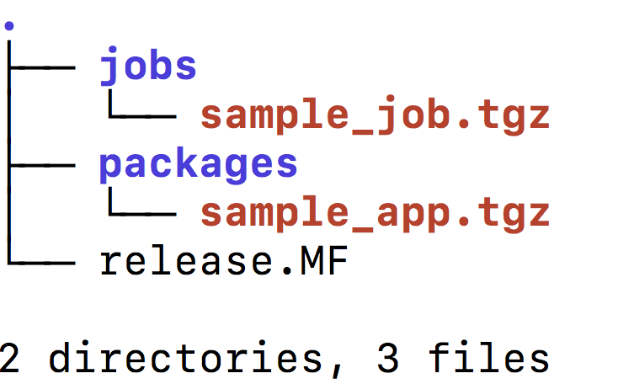
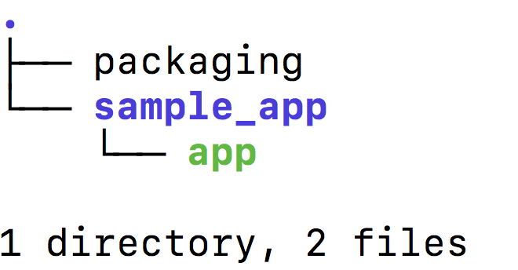
BOSH Packages
A BOSH release contains a set of software packages that can be installed
Each package is stored as a single .tgz file inside of the packages/ directory of the release
A BOSH package must contain a shell script called packaging that will be invoked to produce the binaries that will be installed on a VM
A BOSH package must contain the code/binaries that the packaging script uses to produce the bosh package

Slide 80
Packaging script to install the application on a vm
Packaging script produces a bosh package
Application to be run on a BOSH managed VM
#!/bin/bash
set -e -x
cp -a sample_app/* ${BOSH_INSTALL_TARGET}
#!/bin/bash
while true
do
echo "Sample APP STDOUT!!!"
sleep 1
done

Slide 81
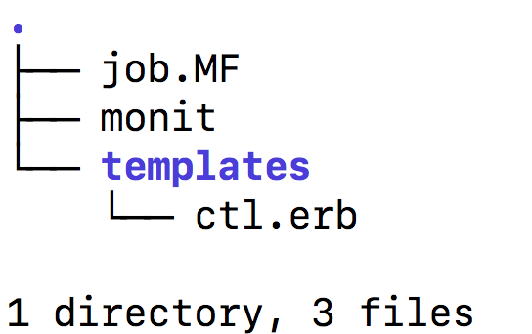
BOSH JOBS
A BOSH job is a set of processes that are configured on a VM
Each job is stored as a single .tgz file inside of the jobs/ directory of the release
A job must contain a job.MF YAML file that contains metadata about the job
A job must contain a monit file that describes how to run and monitor the job
A job may contain a collection of ruby ERB templates that are used to generate the startup and configuration scripts for job

Slide 82
JOB.MF - A YAML metadata file describing the release
---
name: sample_job
templates:
ctl.erb: bin/ctl
packages:
- sample_app
properties: {}

Slide 83

Monit script and templates
Ctl.erb generates ctl shell script used from monit
Monit control script
#!/bin/bash
RUN_DIR=/var/vcap/sys/run/sample_job
LOG_DIR=/var/vcap/sys/log/sample_job
PIDFILE=${RUN_DIR}/pid
case $1 in
start)
mkdir -p $RUN_DIR $LOG_DIR
chown -R vcap:vcap $RUN_DIR $LOG_DIR
echo $$ > $PIDFILE
cd /var/vcap/packages/sample_app
exec ./app \
>> $LOG_DIR/sample_app.stdout.log \
2>> $LOG_DIR/sample_app.stderr.log
;;
stop)
kill -9 `cat $PIDFILE`
rm -f $PIDFILE
;;
*)
echo "Usage: ctl {start|stop}" ;;
esac
check process sample_app
with pidfile /var/vcap/sys/run/sample_job/pid
start program "/var/vcap/jobs/sample_job/bin/ctl start"
stop program "/var/vcap/jobs/sample_job/bin/ctl stop"
group vcap
https://mmonit.com/monit/

Slide 84
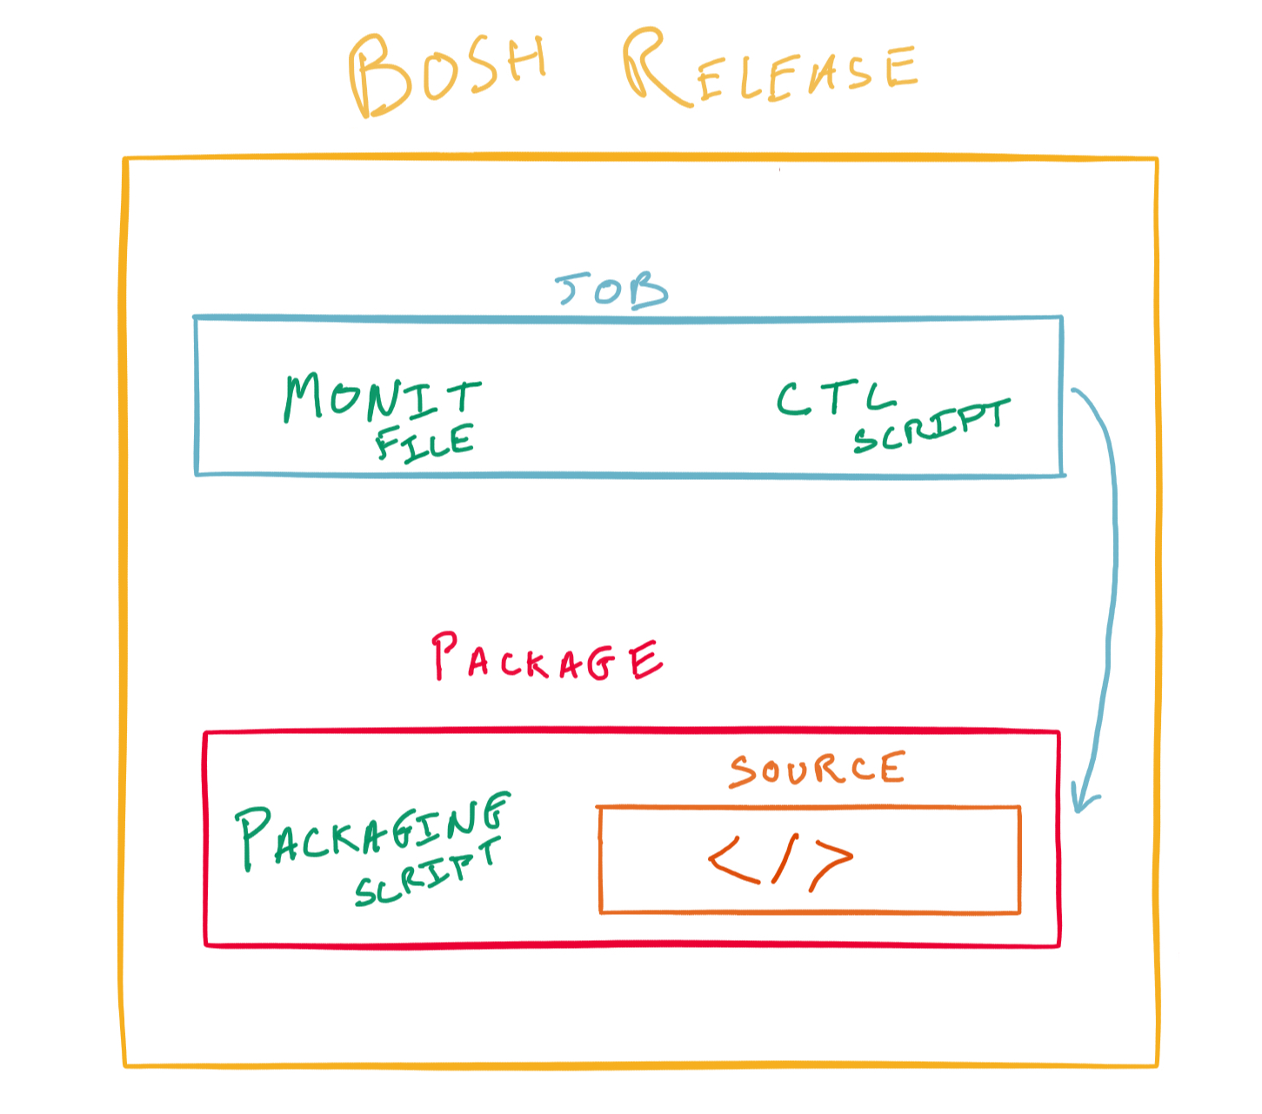

Slide 85
How does BOSH know what we want to deploy?
(Manifests)
BOSH Concepts

Slide 86
Deployment Steps Mapped to BOSH Concepts
Setup Postgres
We need CentOS 7 machine
With 8 GB RAM, 10GB Disk, and one IP Address
Provision the required VM on IaaS (vSphere, AWS, etc)
Get the source for postgres
Compile postgres and install it
Configure postgres as a monitored service
Start postgres and note it’s ip address / port
Setup Tomcat
We need an Ubuntu 16.04 LTS machine
With 4 GB RAM, 10GB Disk, and one IP Address
Provision the required VM on IaaS (vSphere, AWS, etc)
Install the Java Runtime Environment on the VM
Install the Tomcat on the OS
Configure Tomcat as a monitored service
Configure Tomcat data source pointing to postgres
Deploy app into Tomcat
Start tomcat
BOSH stemcell
BOSH deployment manifest
BOSH release
BOSH stemcell
BOSH deployment manifest
BOSH release

Slide 87
Manifests
Typically when creating a machine to run software on you perform the following:
Open an admin console to a server virtualization platform.
Create a virtual machine
Create a disk and add it to the virtual machine
Create a network and add it to the virtual machine
SSH into the virtual machine and Install software
With BOSH this is all encapsulated into a deployment manifest.
A deployment manifest is the explicit declaration of what a software system requires to run successfully.
Tip: The same deployment manifest deployed today should produce the same running system if you deployed it again in five years time.

Slide 88
Deploy a bosh release
Create a deployment manifest
Deploy the release
Learn about bosh tasks
Learn how to monitor a deployment in progress
bosh tasks --debug
Observe for yourself the CPI and stemcell and director in action
Follow Along Demo

Slide 89
Example sample-bosh-manifest.yml
name: sample-bosh-deployment releases: - {name: sample-bosh-release, version: latest} stemcells: - alias: trusty os: ubuntu-trusty version: latest update: canaries: 1 max_in_flight: 10 canary_watch_time: 1000-30000 update_watch_time: 1000-30000
instance_groups: - name: sample_vm instances: 1 networks: - name: default azs: [z1] jobs: - name: sample_job release: sample-bosh-release stemcell: trusty vm_type: default

Slide 90
Deploy the bosh manifest (1)
$ bosh -e my-bosh -d sample-bosh-deployment deploy sample-bosh-manifest.yml Using environment '10.0.0.6' as user 'admin' (openid, bosh.admin) Using deployment 'sample-bosh-deployment' + azs: + - cloud_properties: + zone: us-central1-a + name: z1 + - cloud_properties: + zone: us-central1-f + name: z2
. . . content removed to fit on the screen + name: sample-bosh-deployment + vm_extensions: [] Continue? [yN]: y

Slide 91
Deploy the bosh manifest (2)
$ bosh -e my-bosh -d sample-bosh-deployment deploy sample-bosh-manifest.yml
. . . content from previous screen Task 90 Task 90 | 07:30:17 | Preparing deployment: Preparing deployment (00:00:01) Task 90 | 07:30:18 | Preparing package compilation: Finding packages to compile (00:00:00) Task 90 | 07:30:18 | Compiling packages: sample_app/3698d0cc632d3162a6a2fedcd36ac00364a7cd64 (00:01:32) Task 90 | 07:35:07 | Creating missing vms: sample_vm/1e4aff64-4801-4131-9856-936da97afd02 (0) (00:01:01) Task 90 | 07:36:08 | Updating instance sample_vm: sample_vm/1e4aff64-4801-4131-9856-936da97afd02 (0) (canary) (00:00:17) Task 90 Started Tue Nov 28 07:30:17 UTC 2017 Task 90 Finished Tue Nov 28 07:36:25 UTC 2017 Task 90 Duration 00:06:08 Task 90 done Succeeded

Slide 92
List the instance vms created by the sample deployment
$ bosh instances -d sample-bosh-deployment Using environment '10.0.0.6' as user 'admin' (openid, bosh.admin) Task 93. Done Deployment 'sample-bosh-deployment' Instance Process State AZ IPs sample_vm/1e4aff64-4801-4131-9856-936da97afd02 running z1 10.0.0.12 1 instances Succeeded

Slide 93
List instance vms across all deployments on the director
$ bosh instances Using environment '10.0.0.6' as user 'admin' (openid, bosh.admin) Task 94. Done Deployment 'sample-bosh-deployment' Instance Process State AZ IPs sample_vm/1e4aff64-4801-4131-9856-936da97afd02 running z1 10.0.0.12 1 instances Task 95. Done Deployment 'zookeeper' Instance Process State AZ IPs smoke-tests/1d1aaf87-4305-42a9-bedf-2d7172fd5688 - z1 10.0.0.16 zookeeper/6376b276-8319-41ae-b549-6351545d7284 running z3 10.0.0.15 zookeeper/6d2cfc8b-530a-4e1b-95ae-79fa7dc95444 running z2 10.0.0.13 zookeeper/6e7461c6-1799-4fed-bebb-c7ed946ede54 running z1 10.0.0.11 4 instances Succeeded

Slide 94
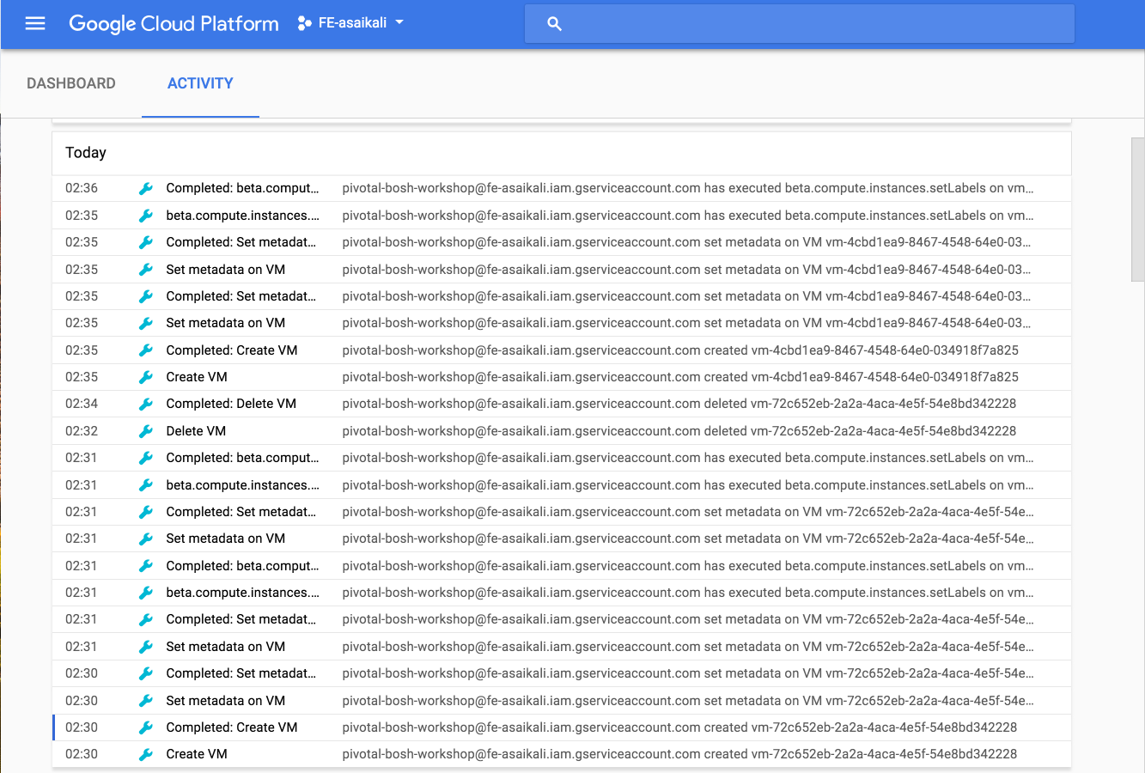
GCP activity log from running the deployment (1)

Slide 95
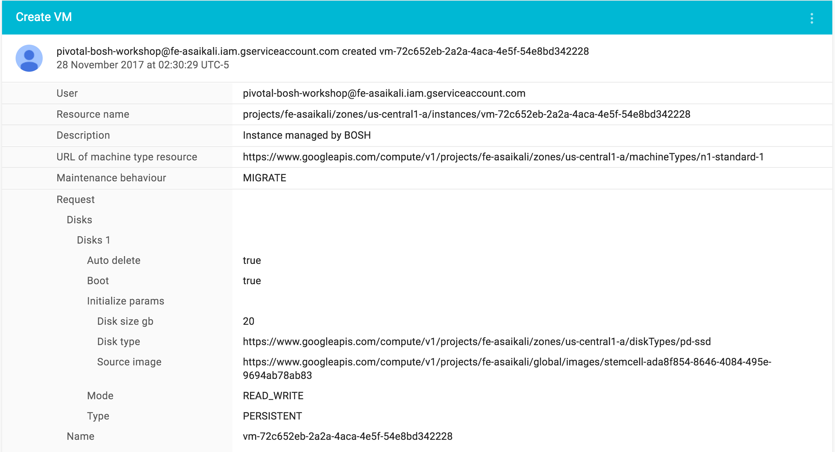
GCP activity log from running the deployment (2)

Slide 96
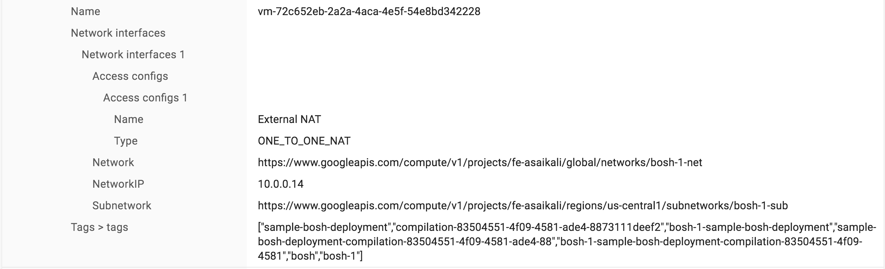
GCP activity log from running the deployment (3)

Slide 97
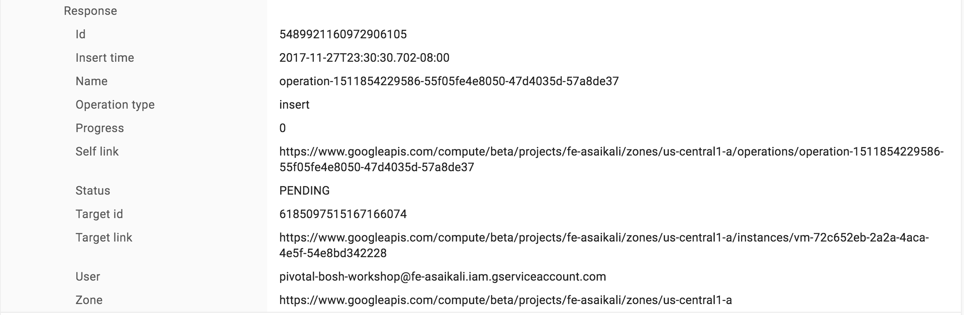
GCP activity log from running the deployment (4)

Slide 98
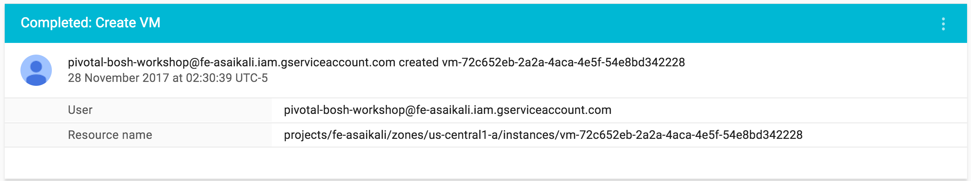
GCP activity log from running the deployment (5)

Slide 99
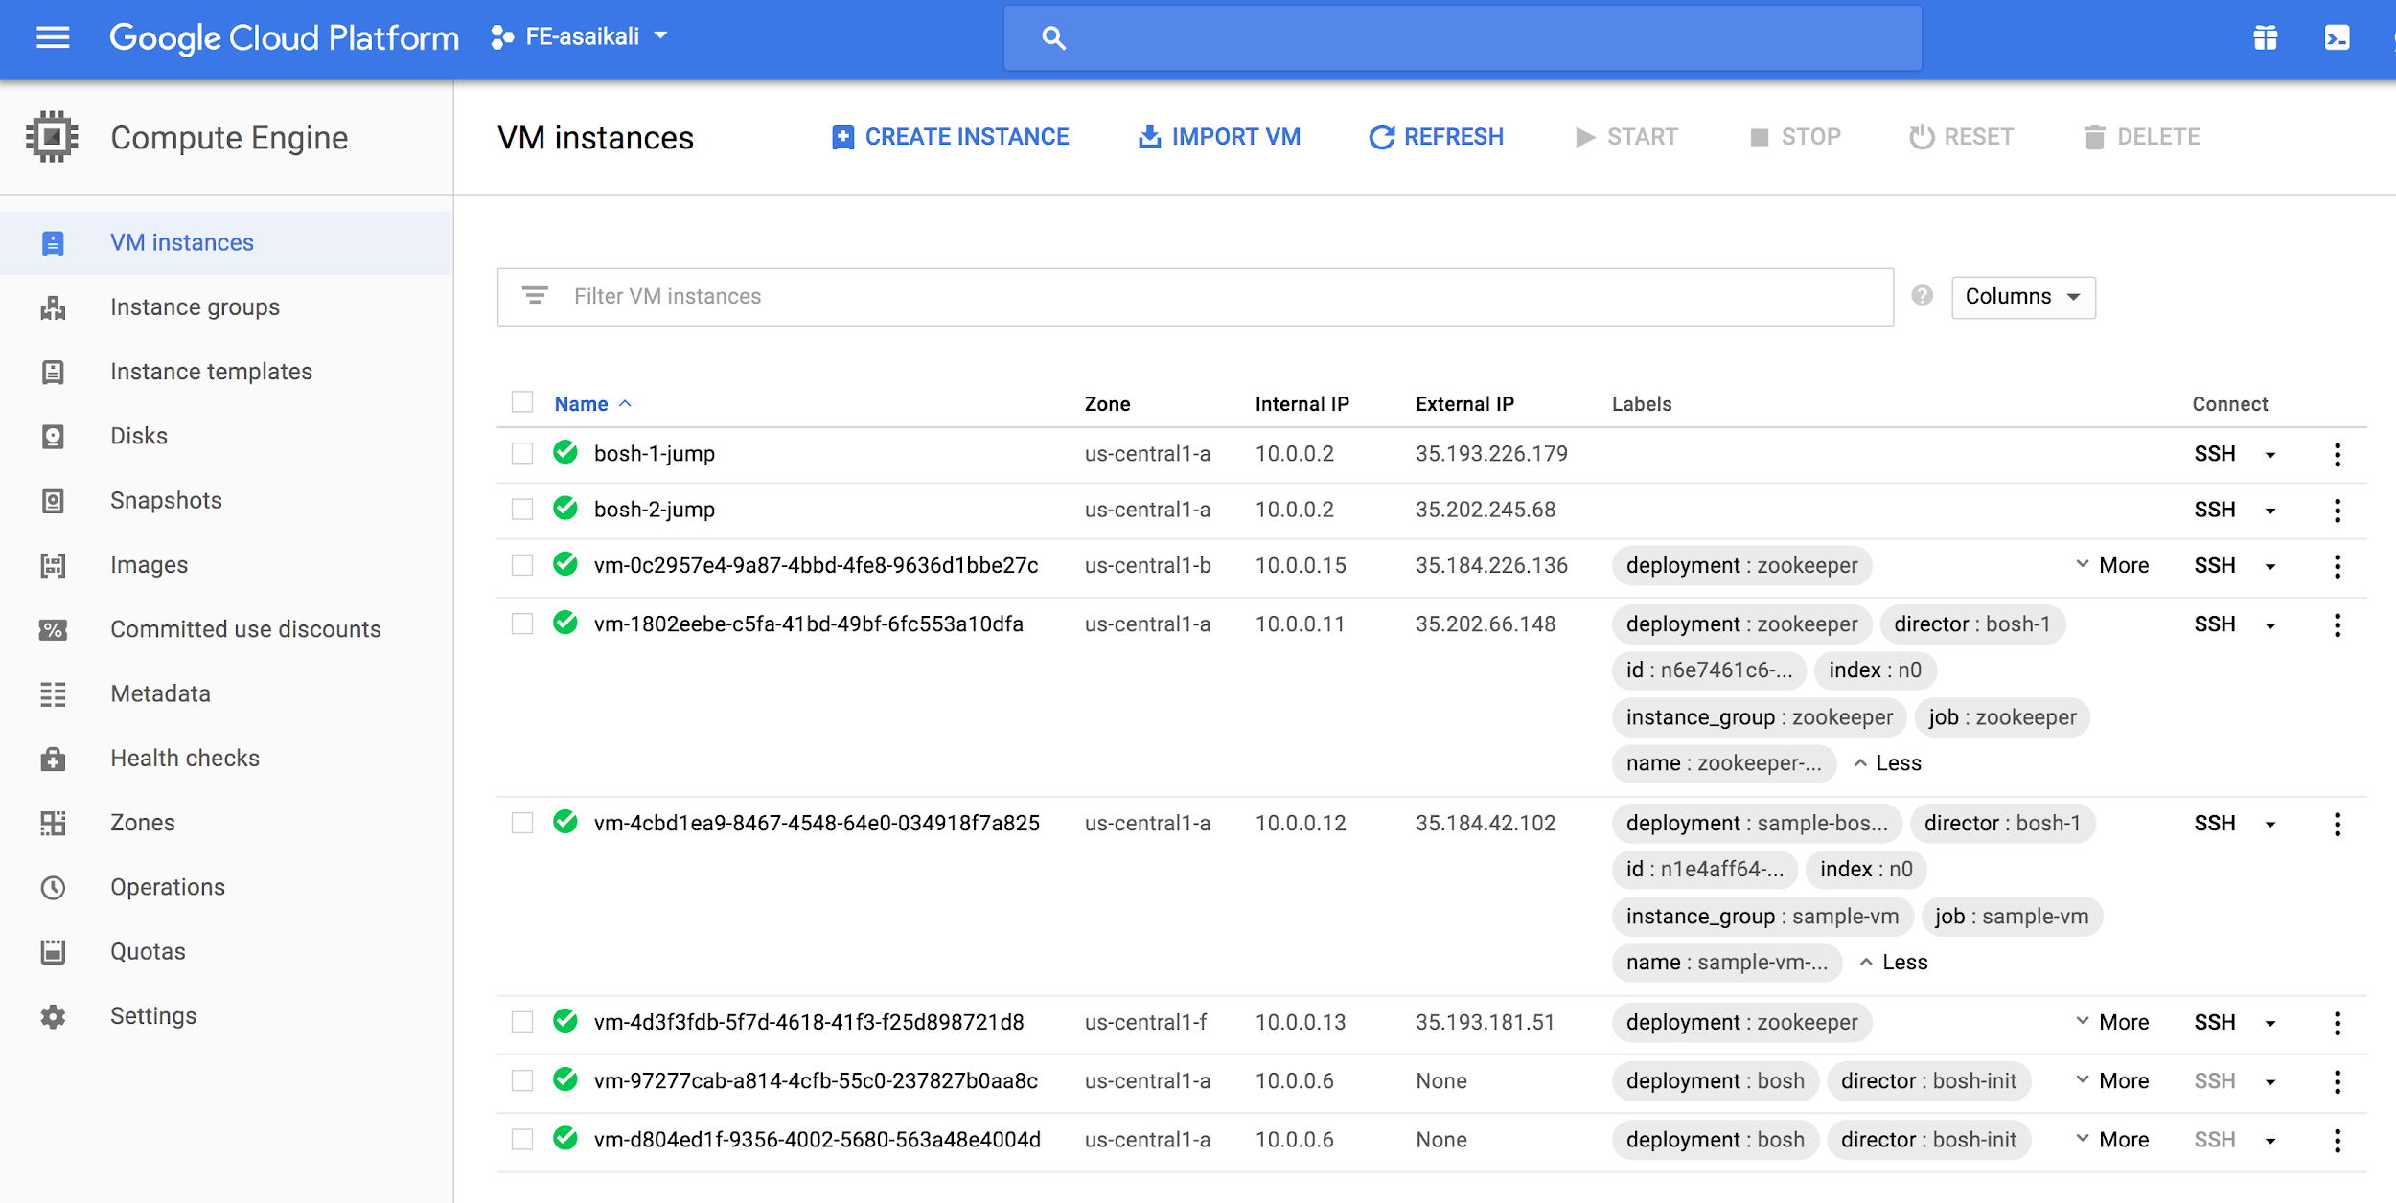
BOSH labels vm’s it creates for easy identification

Slide 100
Returning the list of currently running tasks
$ bosh tasks Using environment '10.0.0.6' as user 'admin' (openid, bosh.admin) ID State Started At Last Activity At User Deployment Description Result 0 tasks Succeeded

Slide 101
Getting the output of a previously executed task
$ bosh task 90 Using environment '10.0.0.6' as user 'admin' (openid, bosh.admin) Task 90 Task 90 | 07:30:17 | Preparing deployment: Preparing deployment (00:00:01) Task 90 | 07:30:18 | Preparing package compilation: Finding packages to compile (00:00:00) Task 90 | 07:30:18 | Compiling packages: sample_app/3698d0cc632d3162a6a2fedcd36ac00364a7cd64 (00:01:32) Task 90 | 07:35:07 | Creating missing vms: sample_vm/1e4aff64-4801-4131-9856-936da97afd02 (0) (00:01:01) Task 90 | 07:36:08 | Updating instance sample_vm: sample_vm/1e4aff64-4801-4131-9856-936da97afd02 (0) (canary) (00:00:17) Task 90 Started Tue Nov 28 07:30:17 UTC 2017 Task 90 Finished Tue Nov 28 07:36:25 UTC 2017 Task 90 Duration 00:06:08 Task 90 done Succeeded

Slide 102
Getting the debug output of a task
$ bosh task 90 --debug
Using environment '10.0.0.6' as user 'admin' (openid, bosh.admin)
Task 90
I, [2017-11-28T07:30:17.553256 #4887] [0x2aeef237af58] INFO -- TaskHelper: Director Version: 264.1.0
I, [2017-11-28T07:30:17.553300 #4887] [0x2aeef237af58] INFO -- TaskHelper: Enqueuing task: 90
I, [2017-11-28T07:30:17 #24101] [] INFO -- DirectorJobRunner: Looking for task with task id 90
D, [2017-11-28T07:30:17 #24101] [] DEBUG -- DirectorJobRunner: (0.000252s) SELECT * FROM "tasks" WHERE "id" = 90
I, [2017-11-28T07:30:17 #24101] [] INFO -- DirectorJobRunner: Found task #<Bosh::Director::Models::Task @values={:id=>90, :state=>"processing", :timestamp=>2017-11-28 07:30:17 UTC, :description=>"create deployment", :result=>nil, :output=>"/var/vcap/store/director/tasks/90", :checkpoint_time=>2017-11-28 07:30:17 UTC, :type=>"update_deployment", :username=>"admin", :deployment_name=>"sample-bosh-deployment", :started_at=>nil, :event_output=>"", :result_output=>"", :context_id=>""}>
. . . many more pages of output excluded to fit on the screen. BOSH makes it easy to keep an audit trail of all the operations it has performed.

Slide 103
How to access BOSH deployed instances?
BOSH Concepts

Slide 104
SSH access to BOSH managed VMs
BOSH is responsible for the lifecycle of a VM (Creating, Patching, Deleting)
BOSH managed VM’s are typically deployed on protected networks that can only be reached from the BOSH director
The BOSH cli provides the bosh ssh command to allow quick access to VMs via ssh

Slide 105
ssh into a bosh instance
ssh into a bosh managed vm
How bosh manages credentials for vms
How to reduce the complexity of accessing vms in different networks
Follow Along Demo

Slide 106
You need the deployment name and instance index or id to ssh into a vm
$ bosh instances Using environment '10.0.0.6' as user 'admin' (openid, bosh.admin) Task 94. Done Deployment 'sample-bosh-deployment' Instance Process State AZ IPs sample_vm/1e4aff64-4801-4131-9856-936da97afd02 running z1 10.0.0.12 1 instances Task 95. Done Deployment 'zookeeper' Instance Process State AZ IPs smoke-tests/1d1aaf87-4305-42a9-bedf-2d7172fd5688 - z1 10.0.0.16 zookeeper/6376b276-8319-41ae-b549-6351545d7284 running z3 10.0.0.15 zookeeper/6d2cfc8b-530a-4e1b-95ae-79fa7dc95444 running z2 10.0.0.13 zookeeper/6e7461c6-1799-4fed-bebb-c7ed946ede54 running z1 10.0.0.11 4 instances Succeeded

Slide 107
bosh ssh
$ bosh ssh zookeeper/0 -d zookeeper
Using environment '10.0.0.6' as user 'admin' (openid, bosh.admin)
Using deployment 'zookeeper'
Task 98. Done
Unauthorized use is strictly prohibited. All access and activity
is subject to logging and monitoring.
Welcome to Ubuntu 14.04.5 LTS (GNU/Linux 4.4.0-97-generic x86_64)
* Documentation: https://help.ubuntu.com/
The programs included with the Ubuntu system are free software;
the exact distribution terms for each program are described in the
individual files in /usr/share/doc/*/copyright.
Ubuntu comes with ABSOLUTELY NO WARRANTY, to the extent permitted by
applicable law.
Last login: Wed Nov 29 01:04:20 2017 from 10.0.0.2
To run a command as administrator (user "root"), use "sudo <command>".
See "man sudo_root" for details.
zookeeper/6e7461c6-1799-4fed-bebb-c7ed946ede54:~$ whoami
bosh_395e8885bb1e4a8
zookeeper/6e7461c6-1799-4fed-bebb-c7ed946ede54:~$ pwd
/var/vcap/bosh_ssh/bosh_395e8885bb1e4a8

Slide 108
How Does BOSH manage processes?
BOSH Concepts

Slide 109
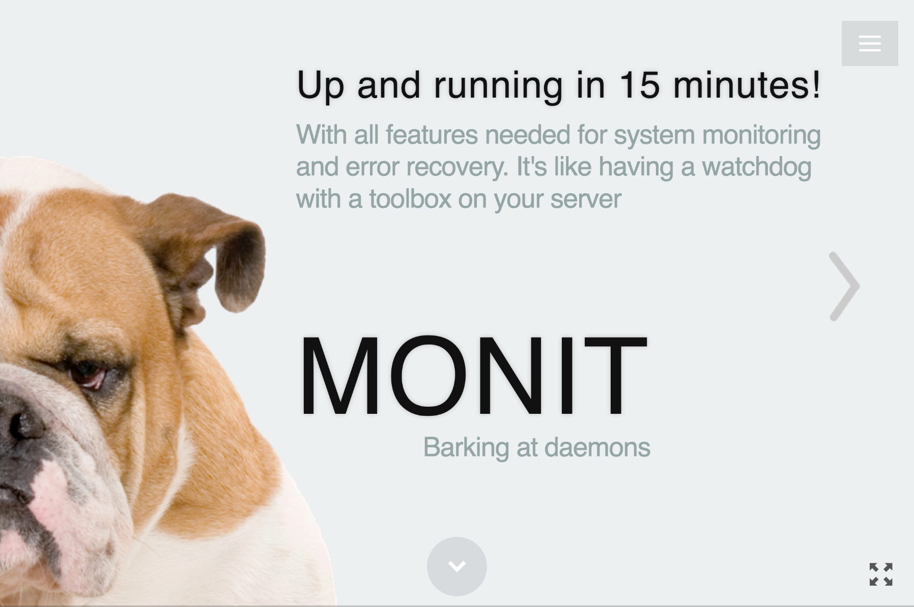
Great slide deck @ https://mmonit.com/monit/

Slide 110
How does BOSH persist state?
BOSH Concepts

Slide 111
BOSH Disk Volume Management
BOSH manages the disks for every VM it creates
Every BOSH VM has small root filesystem 1.5GB that stores the OS
Every BOSH VM has an ephemeral disk volume mounted under /var/vcap/data
The ephemeral disk is deleted when the VM is deleted / recreated
BOSH packages and jobs are stored on the ephemeral disk
BOSH can resize the ephemeral disk volume
A BOSH VM may have a persistent volume mounted under /var/vcap/store
The persistent disk is kept even when a vm is deleted / recreated bosh is able to move the disk volume from one vm instance to another
BOSH can mount multiple persistent disk volumes if needed
BOSH can resize persistent volumes

Slide 112
BOSH instance vm internals
ssh into a BOSH Managed vm
Examine the VM filesystem
Examine the processes running on the vm
Follow Along Demo

Slide 113
BOSH Managed Volumes
zookeeper/6e7461c6-1799-4fed-bebb-c7ed946ede54:~$ df -h Filesystem Size Used Avail Use% Mounted on udev 1.8G 4.0K 1.8G 1% /dev tmpfs 370M 268K 370M 1% /run /dev/sda1 2.8G 1.2G 1.5G 47% / none 4.0K 0 4.0K 0% /sys/fs/cgroup none 5.0M 0 5.0M 0% /run/lock none 1.9G 0 1.9G 0% /run/shm none 100M 0 100M 0% /run/user /dev/sda3 14G 384M 13G 3% /var/vcap/data tmpfs 1.0M 4.0K 1020K 1% /var/vcap/data/sys/run /dev/sdb1 9.8G 23M 9.2G 1% /var/vcap/store

Slide 114
What Does VCAP stand for?
CloudFoundry originated inside VMWare where the project was referred to internally as the VMWare Cloud Application Platform and thus the acronym vcap has stuck around

Slide 115
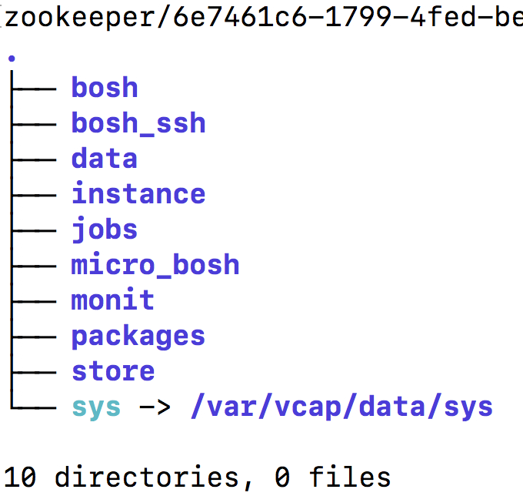
tree /var/vcap -L 1

Slide 116
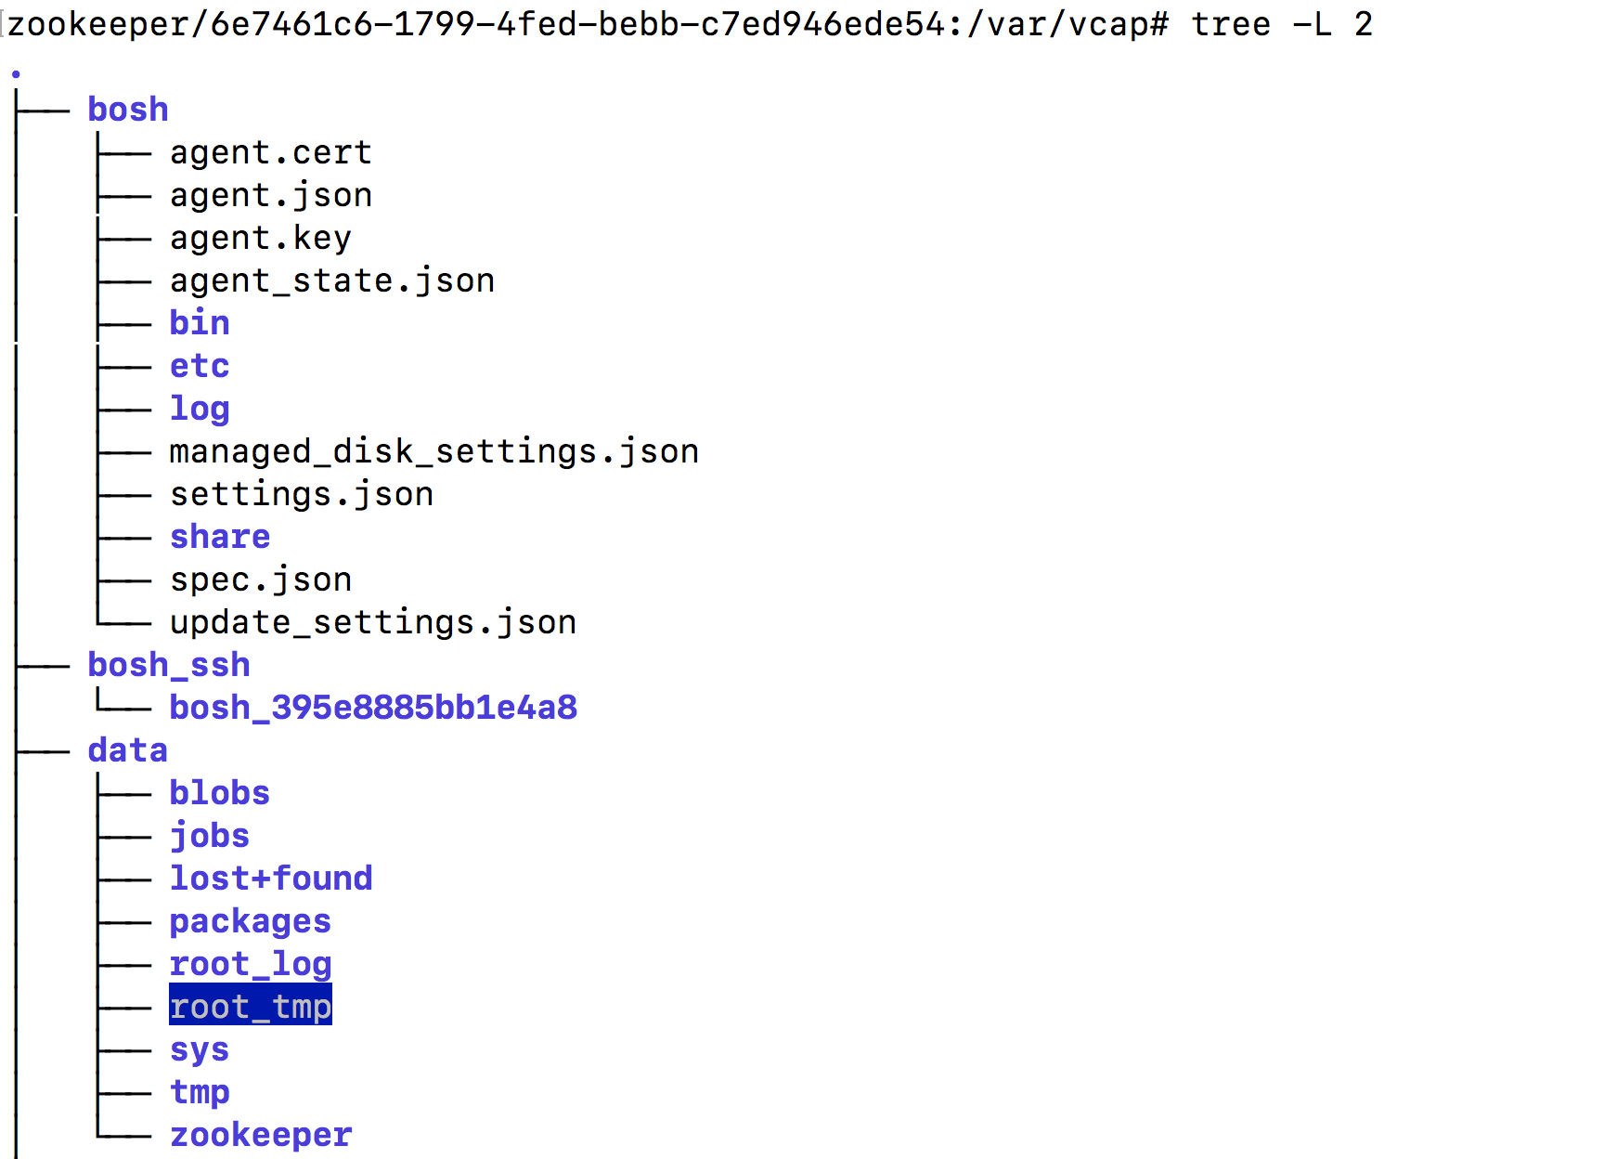
tree /var/vcap -L 2 (1)

Slide 117
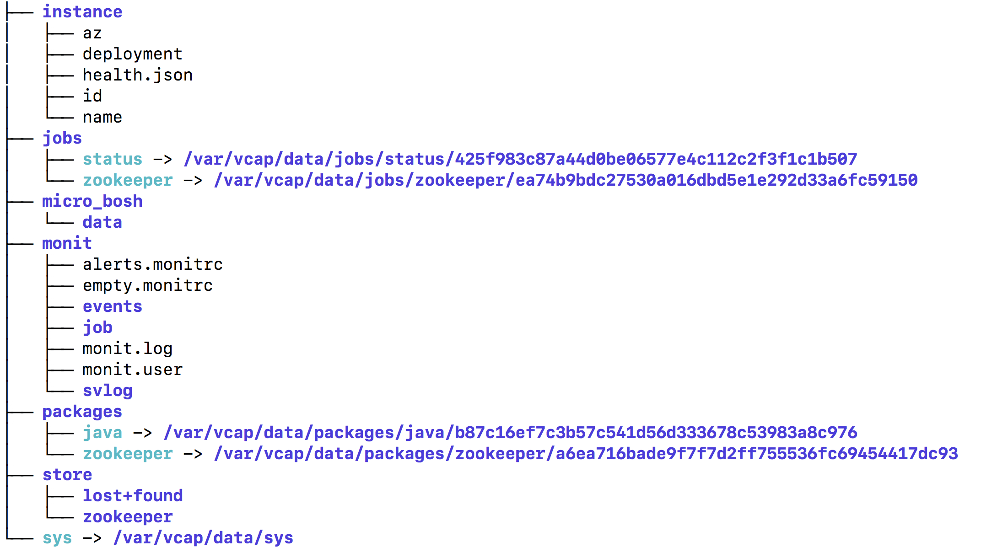
tree /var/vcap -L 2 (2)

Slide 118
Monit summary
zookeeper/6e7461c6-1799-4fed-bebb-c7ed946ede54:/var/vcap/bosh_ssh/bosh_395e8885bb1e4a8# monit summary
The Monit daemon 5.2.5 uptime: 2d 20h 32m
Process 'zookeeper' running
System 'system_localhost' running

Slide 119
Monit status (1)
zookeeper/6e7461c6-1799-4fed-bebb-c7ed946ede54:/var/vcap/bosh_ssh/bosh_395e8885bb1e4a8# monit status
The Monit daemon 5.2.5 uptime: 2d 20h 34m
Process 'zookeeper'
status running
monitoring status monitored
pid 4991
parent pid 1
uptime 2d 20h 34m
children 0
memory kilobytes 66984
memory kilobytes total 66984
memory percent 1.7%
memory percent total 1.7%
cpu percent 0.0%
cpu percent total 0.0%
data collected Wed Nov 29 01:58:35 2017

Slide 120
Monit status (2)
System 'system_localhost'
status running
monitoring status monitored
load average [0.00] [0.00] [0.00]
cpu 0.0%us 0.2%sy 0.0%wa
memory usage 171992 kB [4.5%]
swap usage 0 kB [0.0%]
data collected Wed Nov 29 01:58:35 2017

Slide 121
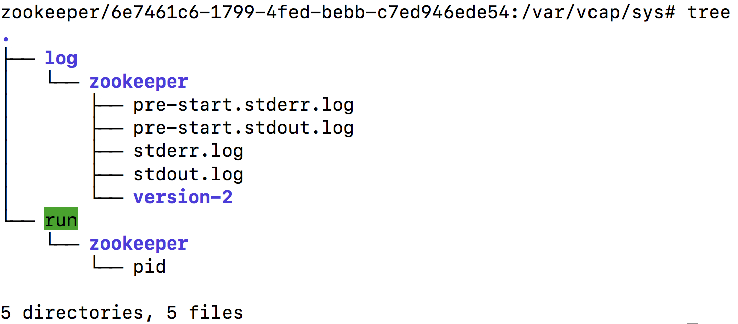
/var/vcap/sys

Slide 122
How does BOSH handle infrastructure configuration changes?
BOSH Concepts

Slide 123
BOSH Converges Actual State to Desired State
BOSH contains a control loop that constantly compares the desired state of a deployment to the actual state
When the desired state is different to the actual state BOSH takes corrective action to converge the two states

Slide 124
BOSH manages Change of VM Configuration
Desired State
Zookeeper BOSH release version 9
5 Node Zookeeper VM cluster
Current State
Zookeeper BOSH release version 9
1 Node Zookeeper VM cluster
BOSH Actions to converge state
Create 4 new VMs
Install Zookeeper 9 on the new VMs
Check that Zookeeper can start

Slide 125
BOSH manges release upgrades
Desired State
Zookeeper BOSH release version 10
5 Node Zookeeper VM cluster
Current State
Zookeeper BOSH release version 9
5 Node Zookeeper VM cluster
BOSH Actions to converge state
Install Zookeeper 10 on 1 VM
Check that Zookeeper starts
Install Zookeeper 10 on 4 VMs
Check that Zookeeper starts

Slide 126
BOSH manages stemcell upgrades
Desired State
3 Node PostgreSQL VM Cluster
Ubuntu Stemcell Version 3468.11
1 Attached Disks / VM
Current State
3 Node PostgreSQL VM Cluster
Ubuntu Stemcell Version 3468.5
1 Attached Disks / VM
Create 2 new VMs with Ubuntu 3468.11
Stop PostgreSQL on 2 VMs
Detach disk from 2 VMs
Attach 2 disks to 2 new VMs
Install PostgreSQL on 2 new VMs
Check that PostgreSQL can start
BOSH Actions to converge state
Create 1 new VMs with Ubuntu 3468.11
Stop PostgreSQL on 1 vm
Detach disk
Attach disk to new VM
Install PostgreSQL on 1st VMs
Check that PostgreSQL can start

Slide 127
Reconfigure a BOSH Deployment
Modify a BOSH deployment
Instruct BOSH to converge the desired state to the actual state
Follow Along Demo

Slide 128
Changing VM type from n1-standard-1 to n1-standard-2 (1)
$ bosh -e my-bosh -d sample-bosh-deployment deploy sample-bosh-manifest.yml
Using environment '10.0.0.6' as user 'admin' (openid, bosh.admin)
Using deployment 'sample-bosh-deployment'
vm_types:
+ - cloud_properties:
+ machine_type: n1-standard-2
+ root_disk_size_gb: 20
+ root_disk_type: pd-ssd
+ name: large
instance_groups:
- name: sample_vm
- vm_type: default
+ vm_type: large
Continue? [yN]:

Slide 129
Changing VM type from n1-standard-1 to n1-standard-2 (2)
Task 102
Task 102 | 03:14:59 | Preparing deployment: Preparing deployment (00:00:00)
Task 102 | 03:14:59 | Preparing package compilation: Finding packages to compile (00:00:00)
Task 102 | 03:14:59 | Updating instance sample_vm: sample_vm/1e4aff64-4801-4131-9856-936da97afd02 (0) (canary) (00:04:39)
Task 102 Started Wed Nov 29 03:14:59 UTC 2017
Task 102 Finished Wed Nov 29 03:19:38 UTC 2017
Task 102 Duration 00:04:39
Task 102 done
Succeeded

Slide 130
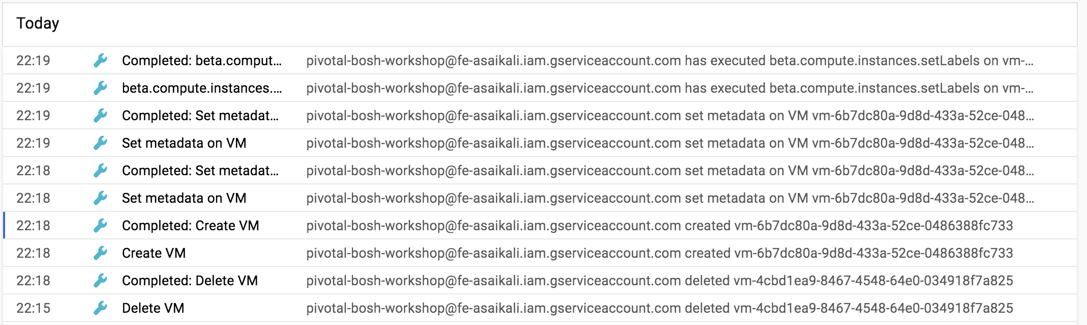
GCP Activities

Slide 131
Get VM Vitals
$ bosh -e my-bosh -d sample-bosh-deployment instances --vitals
Using environment '10.0.0.6' as user 'admin' (openid, bosh.admin)
Task 105. Done
Deployment 'sample-bosh-deployment'
Instance Process State AZ IPs VM Created At Uptime Load CPU CPU CPU CPU Memory Swap System Ephemeral Persistent
(1m, 5m, 15m) Total User Sys Wait Usage Usage Disk Usage Disk Usage Disk Usage
sample_vm/1e4aff64-4801-4131-9856-936da97afd02 running z1 10.0.0.12 Wed Nov 29 03:18:51 UTC 2017 0d 0h 16m 18s 0.00, 0.00, 0.00 - 0.0% 0.1% 0.0% 1% (113 MB) 0% (0 B) 43% (33i%) 0% (0i%) -
1 instances
Succeeded

Slide 132
Authoring a BOSH release
Build the sample bosh release used earlier from scratch
Deploy the sample bosh release
Follow Along Demo

Slide 133
BOSH Errands
BOSH Concepts

Slide 134
BOSH Errands
BOSH offers two types of jobs
Regular jobs
Errands
Regular jobs run continuously and get automatically restarted on failure
Errand jobs are executed upon operator’s request some time after a deploy
If an errand fails it will not get restarted
There is no timeout on how long an errand can execute
Only one errand per deployment can execute at a single time
Errands are typically used to implement smoke-tests to validate that a deployment is functioning from the point of view a user of the deployment

Slide 135
Run BOSH Errands from the Zookeeper release
Run Zookepeer BOSH Errands
Follow Along Demo

Slide 136
Show the errands in a deployment
$ bosh -e my-bosh -d zookeeper errands
Using environment '10.0.0.6' as user 'admin' (openid, bosh.admin)
Using deployment 'zookeeper'
Name
smoke-tests
1 errands
Succeeded

Slide 137
Run the zookeper smoke test (1)
$ bosh -e my-bosh -d zookeeper run-errand smoke-tests
Using environment '10.0.0.6' as user 'admin' (openid, bosh.admin)
Using deployment 'zookeeper'
Task 10
Task 10 | 12:57:22 | Preparing deployment: Preparing deployment
Task 10 | 12:57:23 | Warning: Ambiguous request: the requested errand name 'smoke-tests' matches both a job name and an errand instance group name. Executing errand on all relevant instances with job 'smoke-tests'.
Task 10 | 12:57:23 | Preparing package compilation: Finding packages to compile (00:00:00)
Task 10 | 12:57:23 | Preparing deployment: Preparing deployment (00:00:01)
Task 10 | 12:57:23 | Creating missing vms: smoke-tests/e1cb51cf-d9d1-45eb-9d7f-963e54a9497b (0) (00:00:56)
Task 10 | 12:58:19 | Updating instance smoke-tests: smoke-tests/e1cb51cf-d9d1-45eb-9d7f-963e54a9497b (0) (canary) (00:04:12)
Task 10 | 13:02:31 | Running errand: smoke-tests/e1cb51cf-d9d1-45eb-9d7f-963e54a9497b (0) (00:00:09)
Task 10 | 13:02:40 | Fetching logs for smoke-tests/e1cb51cf-d9d1-45eb-9d7f-963e54a9497b (0): Finding and packing log files (00:00:01)
Task 10 Started Wed Nov 29 12:57:22 UTC 2017
Task 10 Finished Wed Nov 29 13:02:41 UTC 2017
Task 10 Duration 00:05:19
Task 10 done

Slide 138
Run the zookeper smoke test (2)
Instance smoke-tests/e1cb51cf-d9d1-45eb-9d7f-963e54a9497b
Exit Code 0
Stdout -----> simple test
Successfully created value
Successfully retrieved created value
Successfully set new value
Successfully deleted value
-----> phunt/zk-smoketests
Connecting to 10.0.0.11:2181
Connected in 7 ms, handle is 0
Connecting to 10.0.0.12:2181
Connected in 16 ms, handle is 1
Connecting to 10.0.0.13:2181
Connected in 15 ms, handle is 2
Connecting to 10.0.0.14:2181
Connected in 32 ms, handle is 3
Connecting to 10.0.0.15:2181
Connected in 15 ms, handle is 4
Connecting to 10.0.0.11:2181
Connected in 8 ms, handle is 5
Connecting to 10.0.0.15:2181
Connected in 31 ms, handle is 0
Smoke test successful

Slide 139
Run the zookeper smoke test (3)
-----> phunt/zk-latencies (servers)
Connecting to 10.0.0.11:2181
Connected in 7 ms, handle is 0
Connecting to 10.0.0.12:2181
Connected in 7 ms, handle is 1
Connecting to 10.0.0.13:2181
Connected in 7 ms, handle is 2
Connecting to 10.0.0.14:2181
Connected in 8 ms, handle is 3
Connecting to 10.0.0.15:2181
Connected in 7 ms, handle is 4
Testing latencies on server 10.0.0.11:2181 using syncronous calls
created 100 permanent znodes in 263 ms (2.636840 ms/op 379.241770/sec)
set 100 znodes in 202 ms (2.021861 ms/op 494.593823/sec)
get 100 znodes in 33 ms (0.332980 ms/op 3003.181968/sec)
deleted 100 permanent znodes in 176 ms (1.766059 ms/op 566.232371/sec)
created 100 ephemeral znodes in 193 ms (1.938350 ms/op 515.902647/sec)
watched 100 znodes in 31 ms (0.317979 ms/op 3144.863163/sec)
deleted 100 ephemeral znodes in 196 ms (1.966619 ms/op 508.486774/sec)
notif 100 watches in 0 ms (included in prior)

Slide 140
Run the zookeper smoke test (4)
-----> phunt/zk-latencies (cluster)
Connecting to 10.0.0.11:2181,10.0.0.12:2181,10.0.0.13:2181,10.0.0.14:2181,10.0.0.15:2181
Connected in 7 ms, handle is 0
Testing latencies on server 10.0.0.11:2181,10.0.0.12:2181,10.0.0.13:2181,10.0.0.14:2181,10.0.0.15:2181 using syncronous calls
created 100 permanent znodes in 213 ms (2.139702 ms/op 467.354834/sec)
set 100 znodes in 193 ms (1.932962 ms/op 517.340760/sec)
get 100 znodes in 36 ms (0.360720 ms/op 2772.232100/sec)
deleted 100 permanent znodes in 217 ms (2.173791 ms/op 460.025840/sec)
created 100 ephemeral znodes in 202 ms (2.022221 ms/op 494.505772/sec)
watched 100 znodes in 50 ms (0.502579 ms/op 1989.736097/sec)
deleted 100 ephemeral znodes in 185 ms (1.853170 ms/op 539.615786/sec)
notif 100 watches in 0 ms (included in prior)
Latency test complete
Stderr 2017/11/29 13:02:31 Connected to 10.0.0.11:2181
2017/11/29 13:02:31 Authenticated: id=99087679217795072, timeout=4000
2017/11/29 13:02:31 Re-submitting `0` credentials after reconnect
2017/11/29 13:02:31 Recv loop terminated: err=EOF
2017/11/29 13:02:31 Send loop terminated: err=<nil>
1 errand(s)
Succeeded

Slide 141
Upgrade a BOSH release
Upgrade the Zookeeper release
Follow Along Demo

Slide 142
Upload the latest zookeper release
$ bosh -e my-bosh upload-release https://bosh.io/d/github.com/cppforlife/zookeeper-release?v=0.0.7 --sha1 a863ef216ea75d22950703a3c924959cb20e59ba
Using environment '10.0.0.6' as user 'admin' (openid, bosh.admin)
Task 12
Task 12 | 13:46:30 | Downloading remote release: Downloading remote release (00:00:03)
Task 12 | 13:46:33 | Verifying remote release: Verifying remote release (00:00:01)
Task 12 | 13:46:34 | Extracting release: Extracting release (00:00:02)
Task 12 | 13:46:37 | Verifying manifest: Verifying manifest (00:00:00)
Task 12 | 13:46:38 | Resolving package dependencies: Resolving package dependencies (00:00:00)
Task 12 | 13:46:38 | Creating new packages: golang-1.8-linux/3eac55db0483de642b1be389966327e931db3e3f (00:00:04)
Task 12 | 13:46:42 | Creating new packages: smoke-tests/ec91e258c41471227a759c2749e7295cb65eff5a (00:00:01)
Task 12 | 13:46:43 | Processing 2 existing packages: Processing 2 existing packages (00:00:00)
Task 12 | 13:46:43 | Creating new jobs: status/1a6e60e211521487e4d03c8f7dc652b27a9ee368 (00:00:00)
Task 12 | 13:46:43 | Processing 2 existing jobs: Processing 2 existing jobs (00:00:00)
Task 12 | 13:46:43 | Release has been created: zookeeper/0.0.7 (00:00:00)
Task 12 Started Wed Nov 29 13:46:30 UTC 2017
Task 12 Finished Wed Nov 29 13:46:43 UTC 2017
Task 12 Duration 00:00:13
Task 12 done

Slide 143
Check which releases are available in the director
$ bosh -e my-bosh releases
Using environment '10.0.0.6' as user 'admin' (openid, bosh.admin)
Name Version Commit Hash
zookeeper 0.0.7 e7ead22
~ 0.0.6* 2f8926f
(*) Currently deployed
(+) Uncommitted changes
2 releases
Succeeded

Slide 144
Deploy the updated release
$ bosh -e my-bosh -d zookeeper deploy ~/zookeeper-manifest.yml
Using environment '10.0.0.6' as user 'admin' (openid, bosh.admin)
Using deployment 'zookeeper'
releases:
- name: zookeeper
- version: 0.0.6
+ version: 0.0.7
Continue? [yN]: y
Task 13
Task 13 | 13:48:13 | Preparing deployment: Preparing deployment (00:00:01)
Task 13 | 13:48:14 | Preparing package compilation: Finding packages to compile (00:00:00)
Task 13 | 13:48:14 | Compiling packages: golang-1.8-linux/3eac55db0483de642b1be389966327e931db3e3f (00:01:36)
Task 13 | 13:49:50 | Compiling packages: smoke-tests/ec91e258c41471227a759c2749e7295cb65eff5a (00:00:18)
Task 13 Started Wed Nov 29 13:48:13 UTC 2017
Task 13 Finished Wed Nov 29 13:50:08 UTC 2017
Task 13 Duration 00:01:55
Task 13 done
Succeeded

Slide 145
BOSH Add-Ons
BOSH Concepts

Slide 146
BOSH Add-Ons
BOSH add-ons are releases that can be installed on all vms managed by BOSH
Great mechanism to install agents onto VMs
Anti-Virus
File Integrity Monitoring
IPSEC
… etc

Slide 147
BOSH Runtime-Config & Add-ons
Upgrade the Zookeeper release
Follow Along Demo

Slide 148
What are the top things you learned today about BOSH?
Discussion

Slide 149

세상의 소프트웨어 개발 문화를 혁신하는 Pivotal
© Copyright 2017 Pivotal Software, Inc. All rights Reserved.

